Slide 1

Why are we studying this???
To be a valuable contributor to society
To get a good university entrance score...
What is your reply?
You need to know this for your test...
It will open up your job opportunities…
It’s just important… trust me…
So you don’t get ripped off
But do these statements really ‘cut it’?
Notes:
What is the story behind each of these messages?
If we continue tell students that “they need to study this because it’s in the test” – we are expressing the worldview that tests are important. However why are tests important? By implication why is it important to do well in a test? For the future? Why?
Why is any of this learning important?

Slide 2

Why do we learn Mathematics?
What do I love about Mathematics?

Slide 3
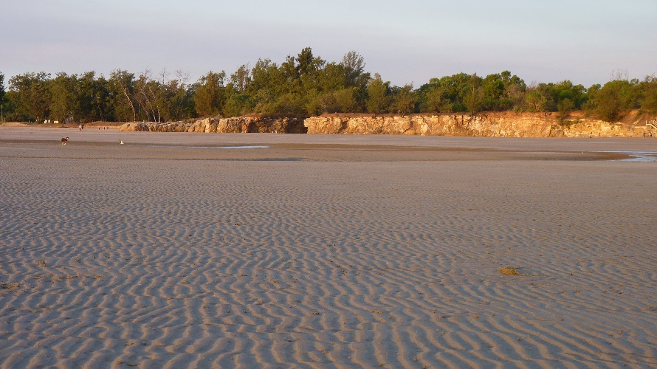

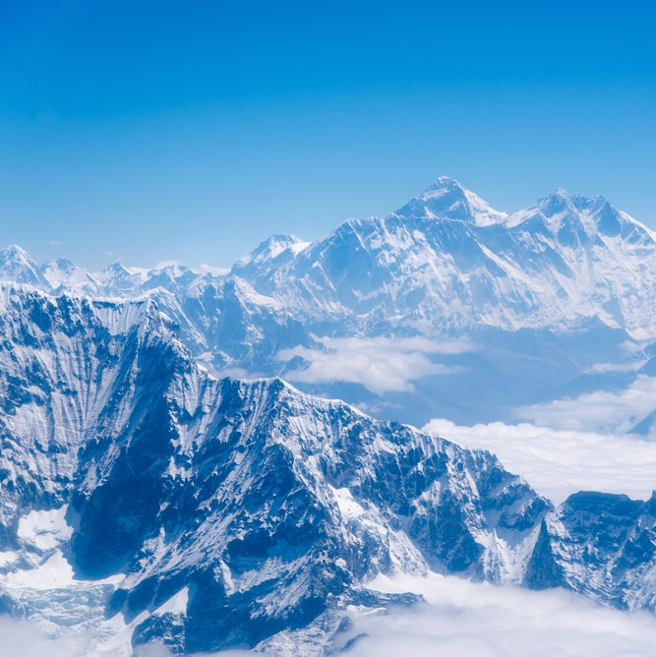


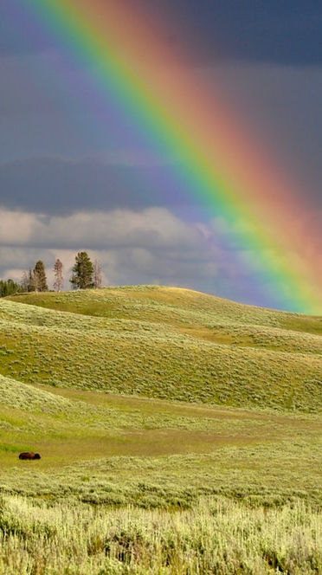
Mathematics helps us understand more fully God’s beautiful creation

Slide 4
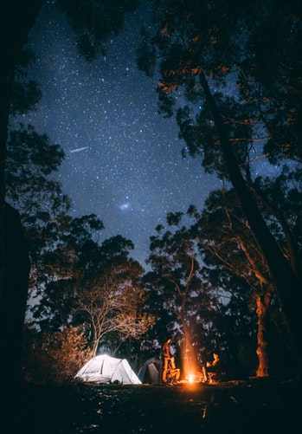
How many stars are there?
Why did God create stars?
How do we know anything about stars?
Notes:
Photo: Forage, J.

Slide 5
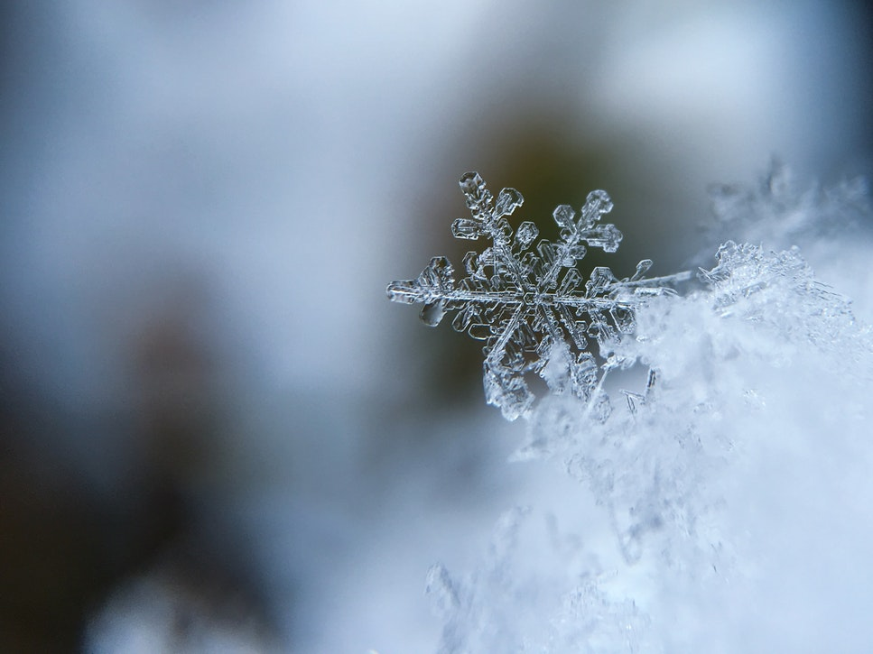
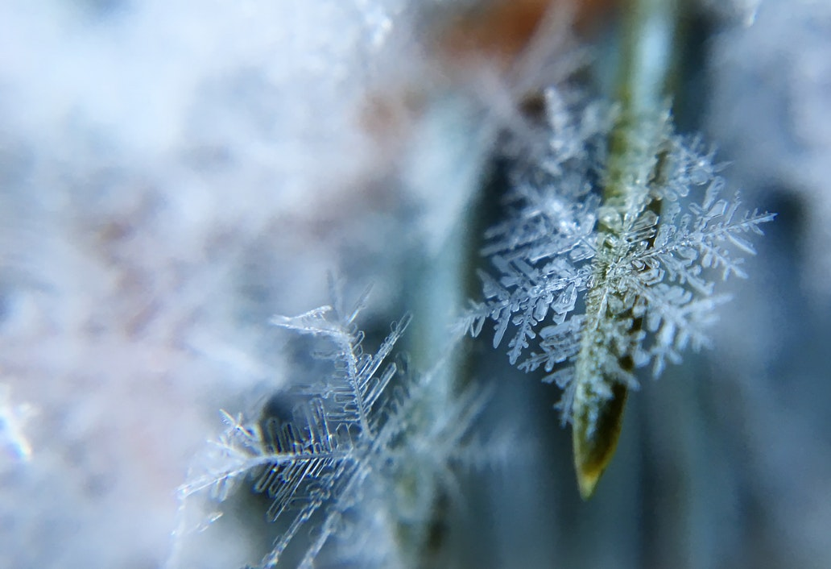
What makes snowflakes so beautiful?
Why did God do this?
Notes:
Burden, A.

Slide 6
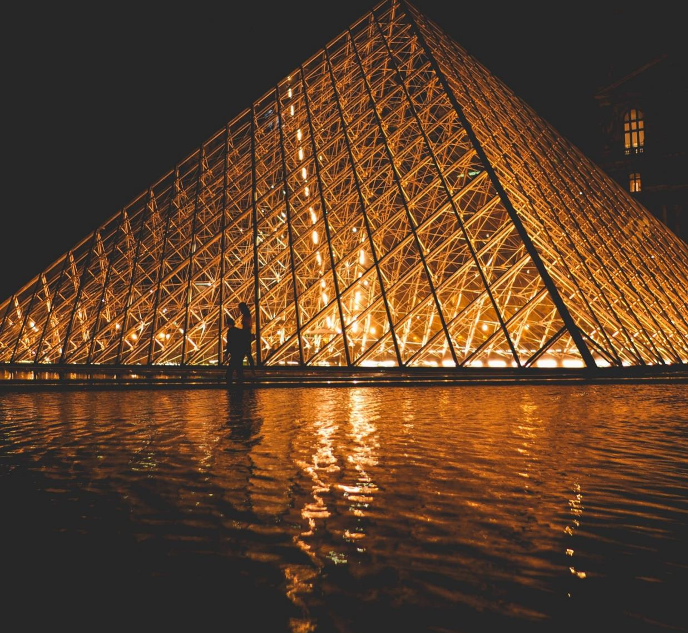

Truth and constancy
Mathematics is always true.
It builds truth upon truth.
It is reliable
Its laws are unchanging in a dynamic world
Notes:
I love how mathematics remains true and builds truth upon truth, reflecting an unchanging property of the universe upon which we can rely and build our lives
Photo by Bart Kerswell on Unsplash
Image Soumya-8974, CC BY-SA 4.0 <https://creativecommons.org/licenses/by-sa/4.0>, via Wikimedia Commons
Photo by Nicolas Pierson on Unsplash

Slide 7

Humans are made in God’s image - we use mathematics to create beauty to bless others

Slide 8

How is a soccer ball beautiful?
What shapes are used to form a soccer ball?
Notes:
Glaser, P.

Slide 9
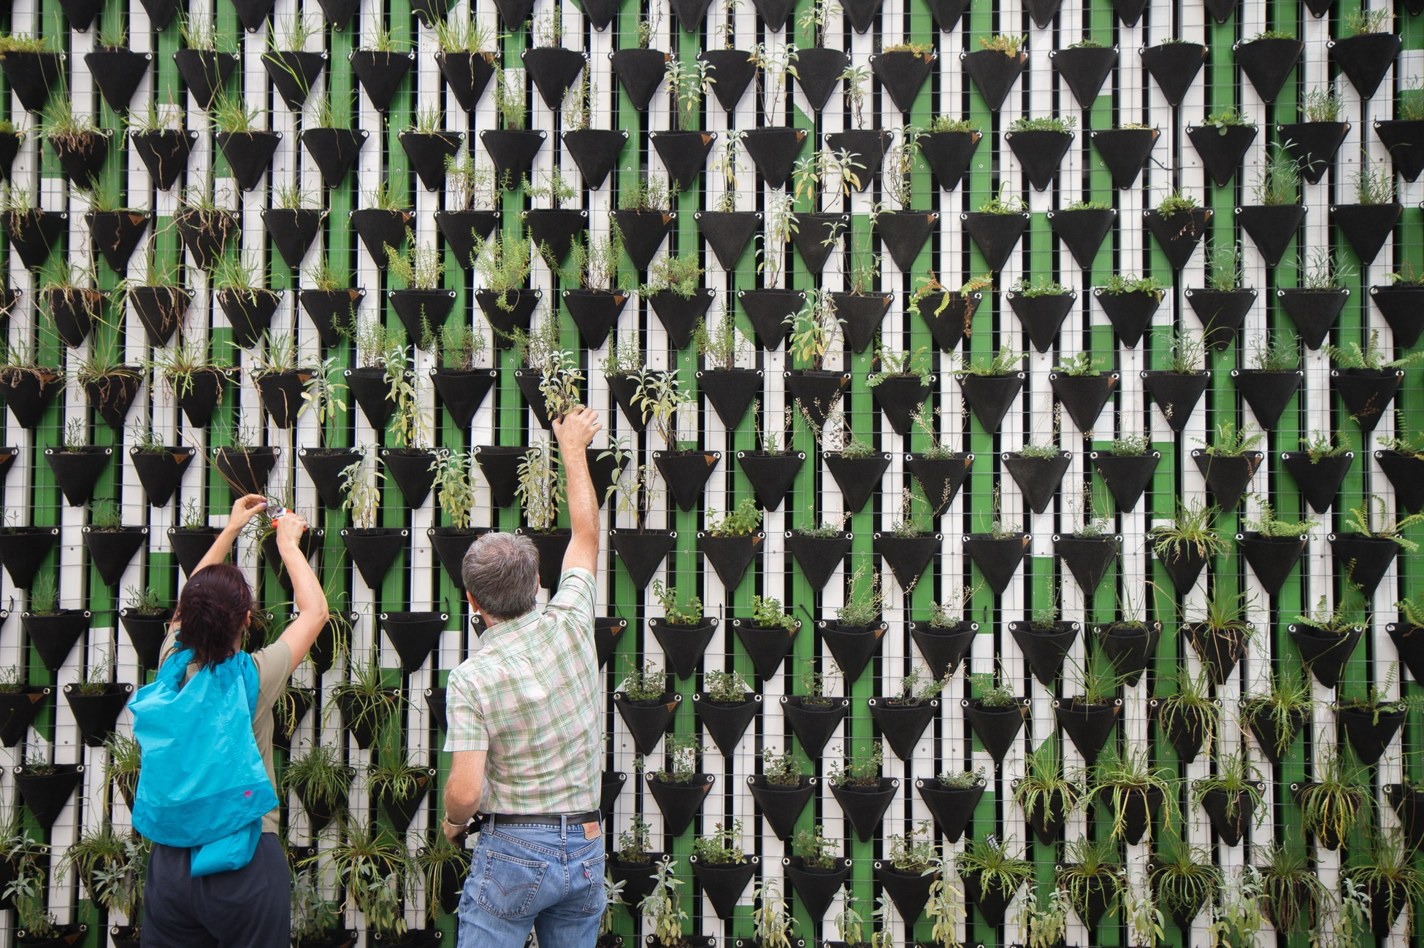
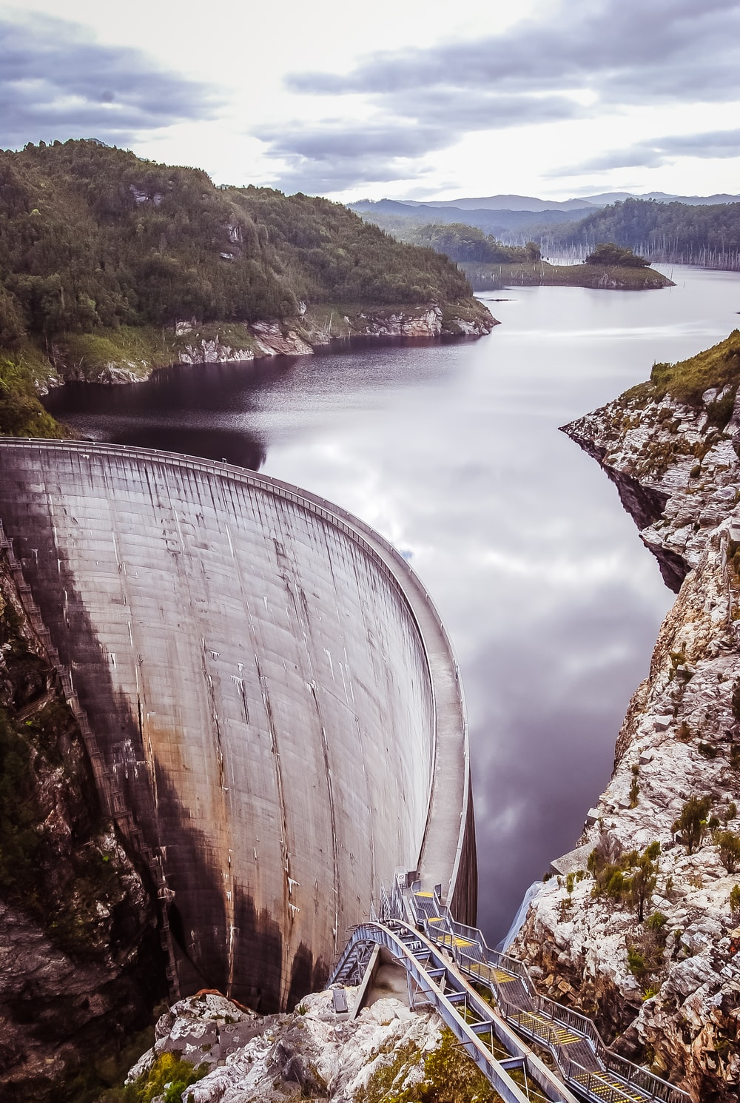
We use mathematics to serve others in our community

Slide 10
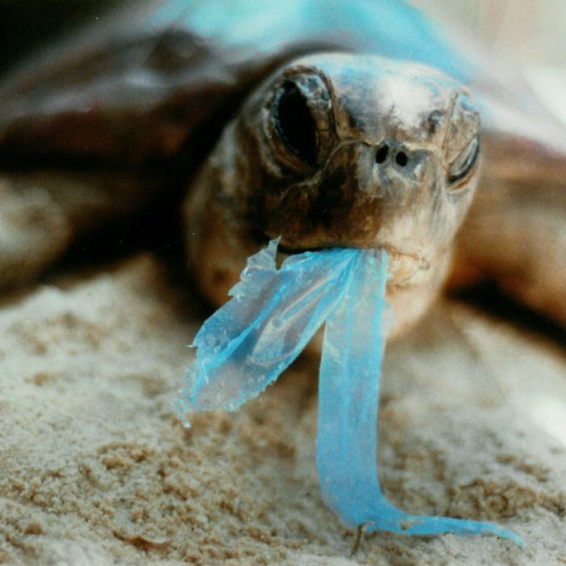
Is this a problem?
What can we do about it?

Slide 11
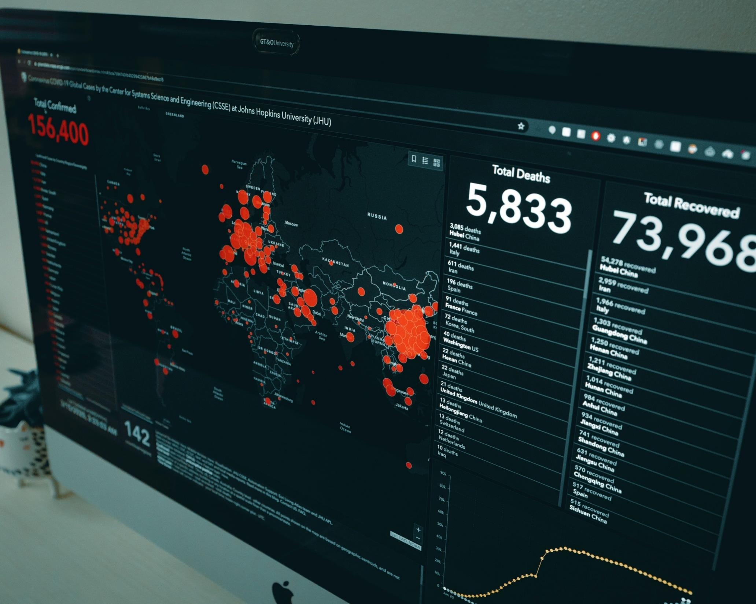
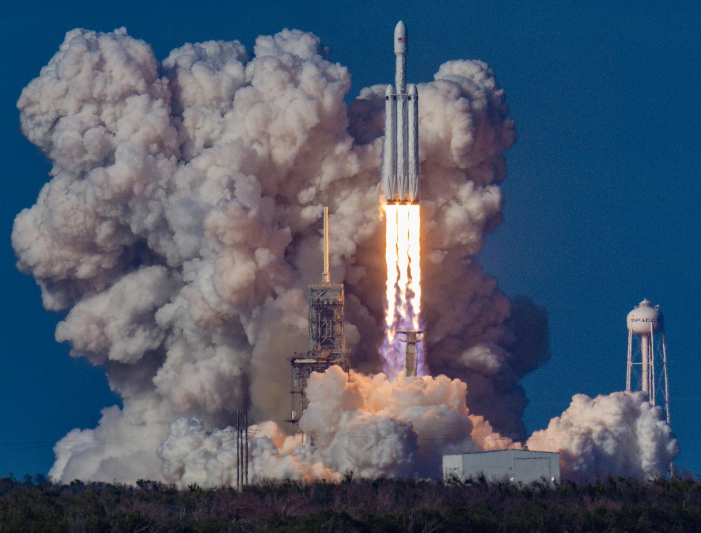
Mathematics contains powerful concepts
For example, it helps us:
Understand disease
Launch (and land) rockets
With Economics, Engineering, Agriculture…
With visual art, music, dance, theatre…
Notes:
Mathematics enables us to be precise about our description of the world and helps us to make accurate predictions.
Photo by Clay Banks on Unsplash
Photo by Bill Jelen on Unsplash

Slide 12
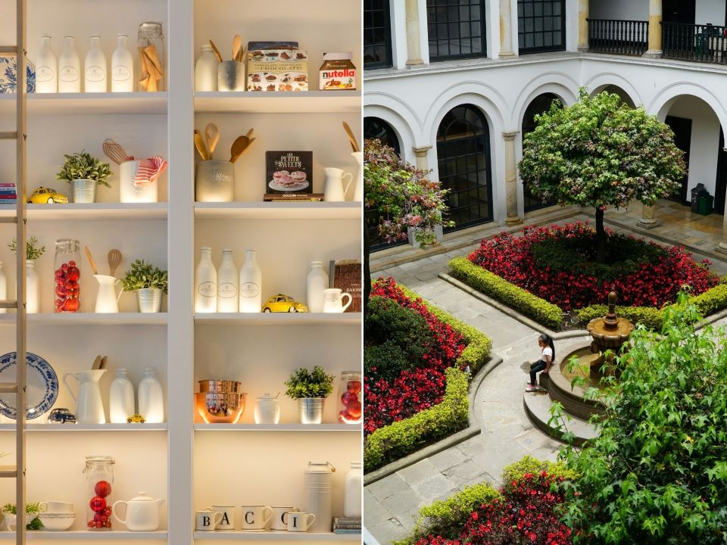
God used mathematics in creation to bring about order from chaos. We too, who are made in His image, can also use it to organise and bring about order.

Slide 13
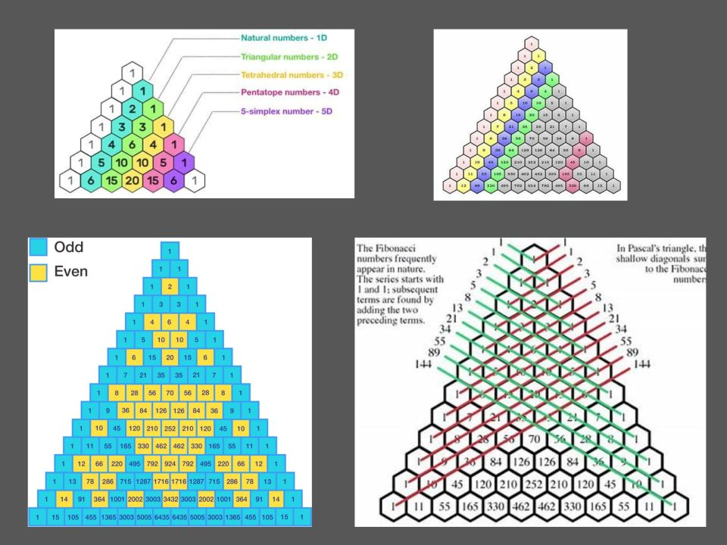
Numbers themselves are beautiful!

Slide 14
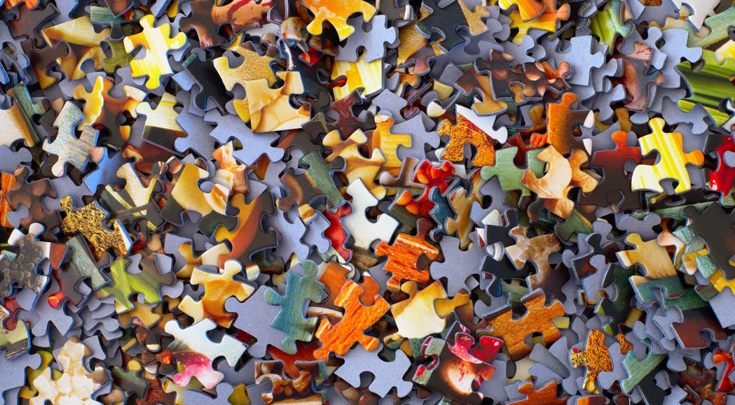
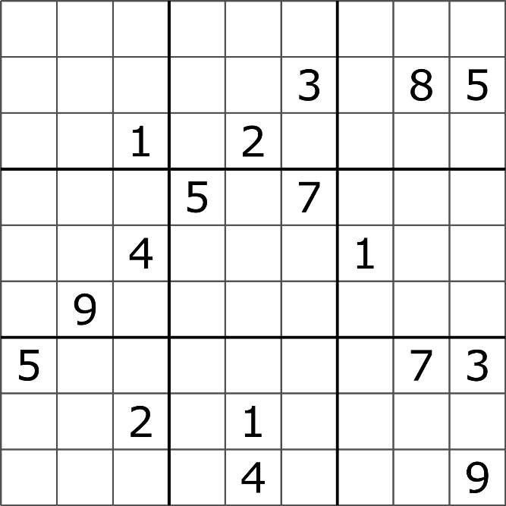
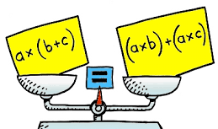
We are made in God’s image: ‘wired’ to manipulate numbers and solve mathematical puzzles
It is enjoyable!!!

Slide 15


What puzzles do you like solving?

Slide 16


We all use it … everyday!

Slide 17
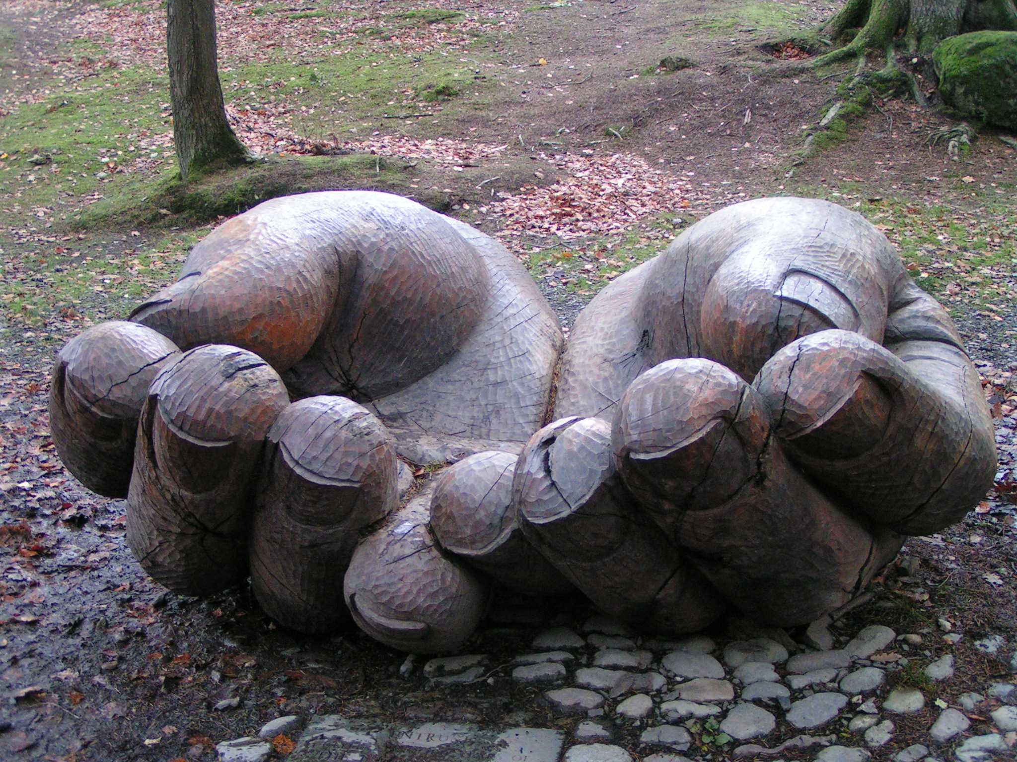
Mathematics helps us stand in awe of God as we consider the beautiful patterns that make up His world.
Our deep hope is that students can use Mathematics to be good stewards of all that God has given them: to be fully equipped to use Mathematics to the best of their ability and lovingly serve in their communities.

