Slide 1


Highest and lowest places on earth
Using integers to Explore God’s amazing creation

Slide 2
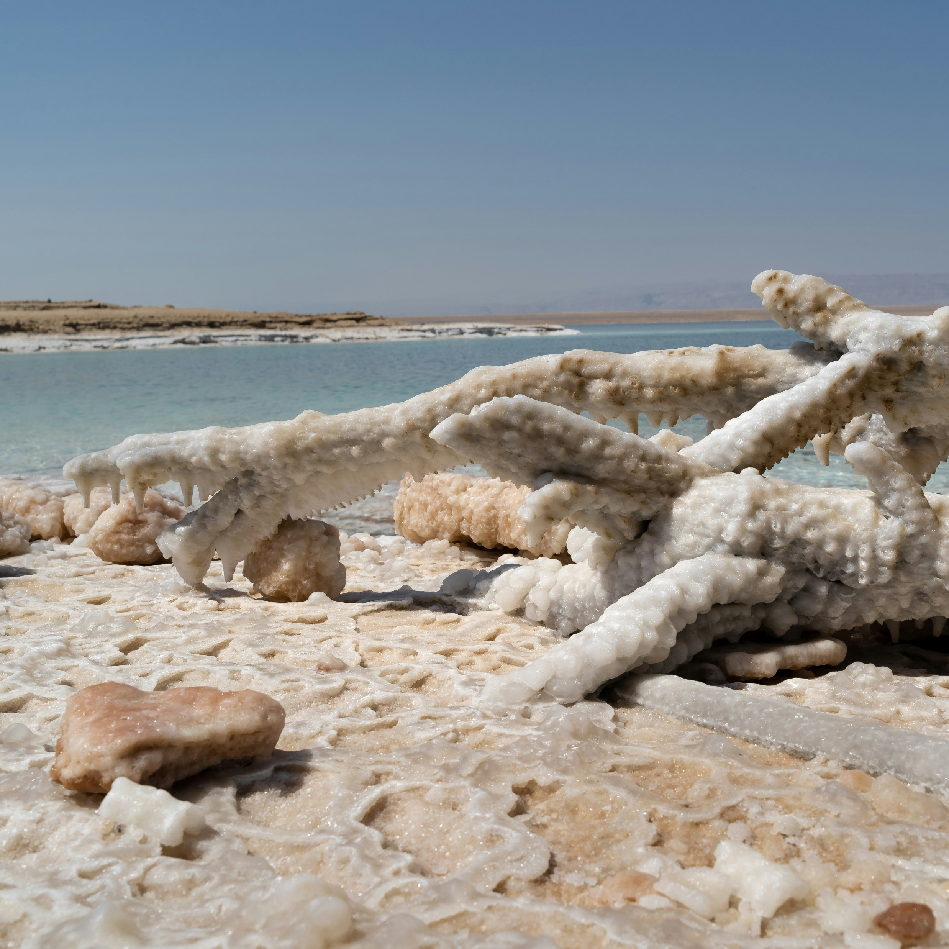
Dead Sea
The lowest point on earth
(that you can stand on)
-397m

Slide 3


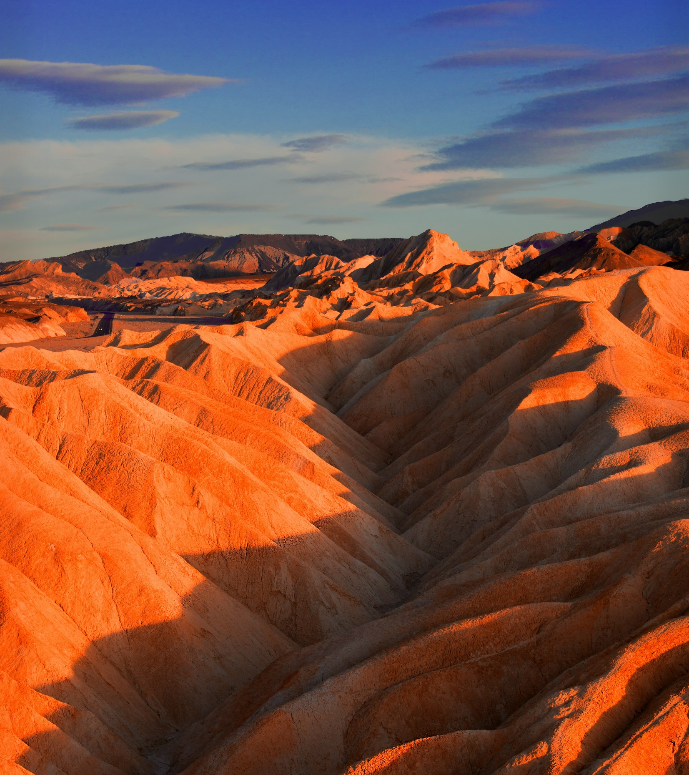



Death Valley
-86m

Slide 4
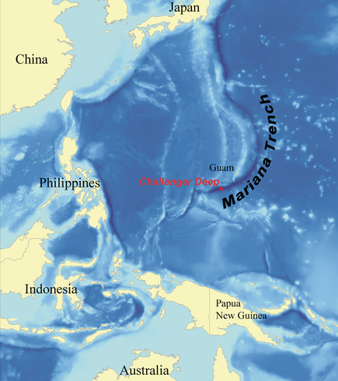
Mariana Trench
Deepest point in the ocean
-10,994 m

Slide 5
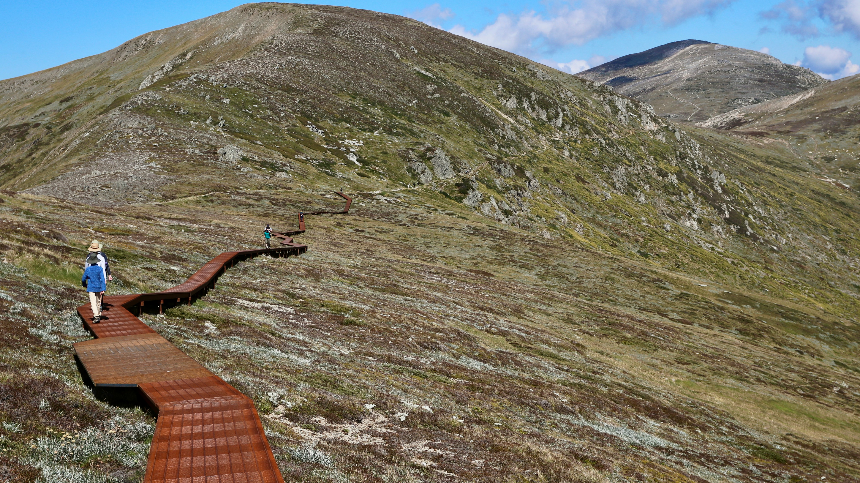
Mount Kosciuszko
2230m

Slide 6
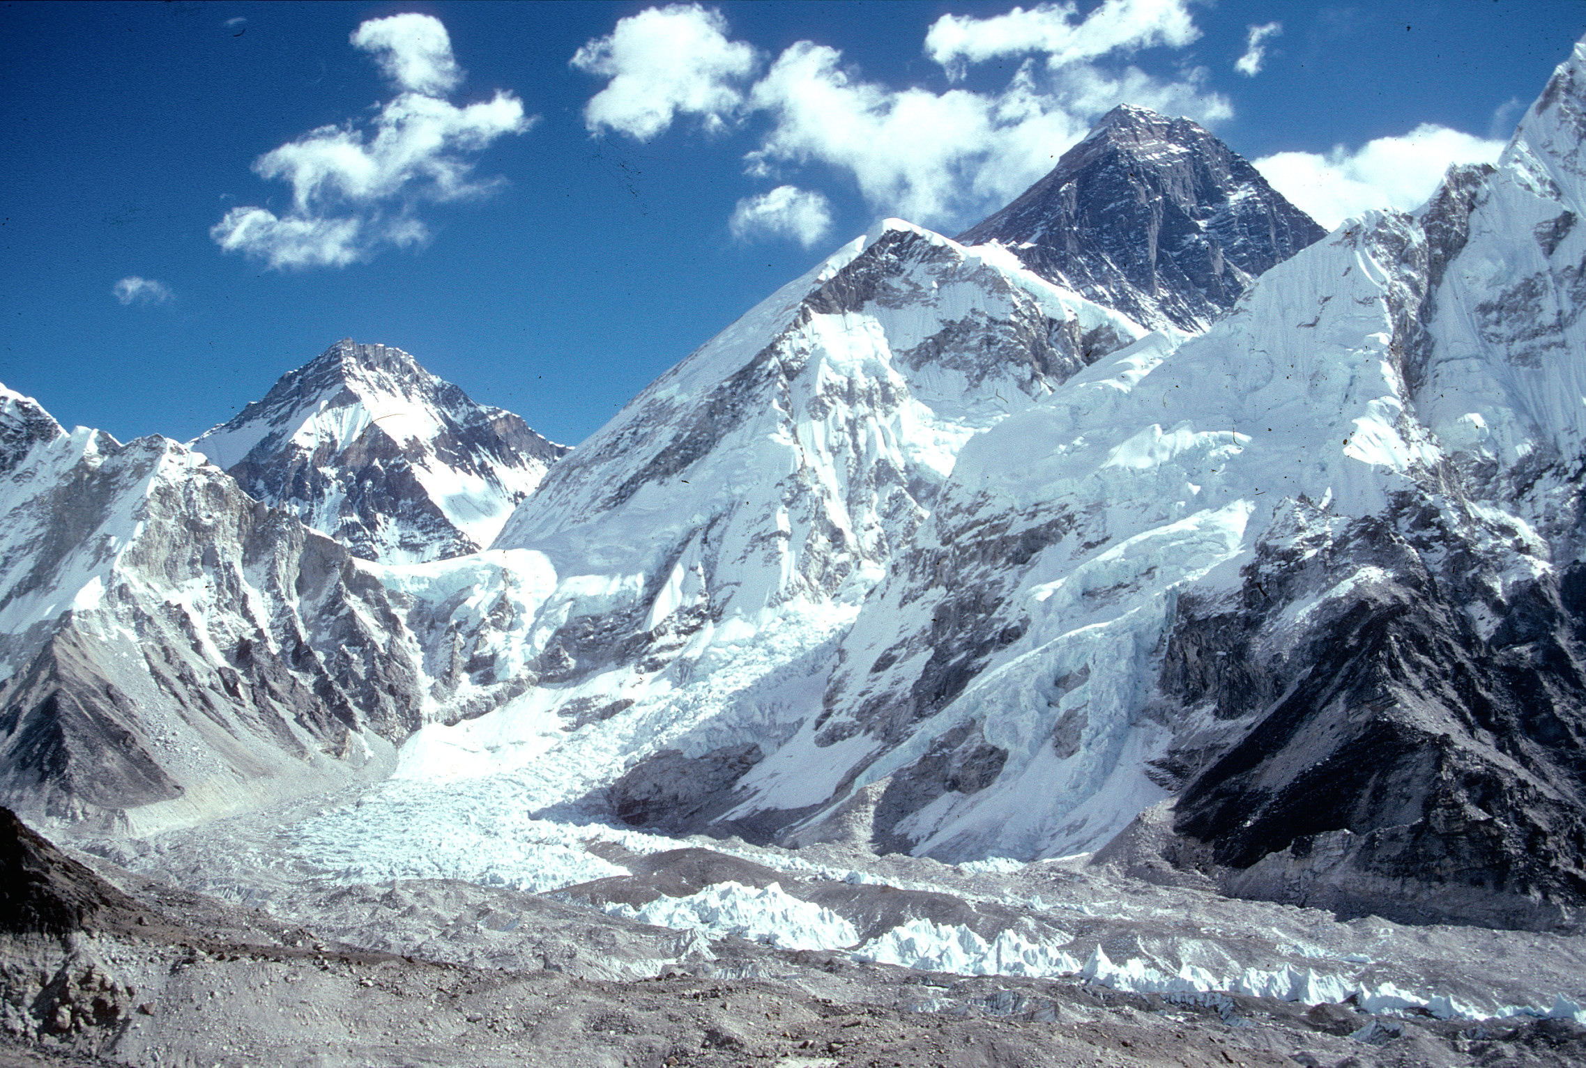
Mount Everest 8840m

Slide 7
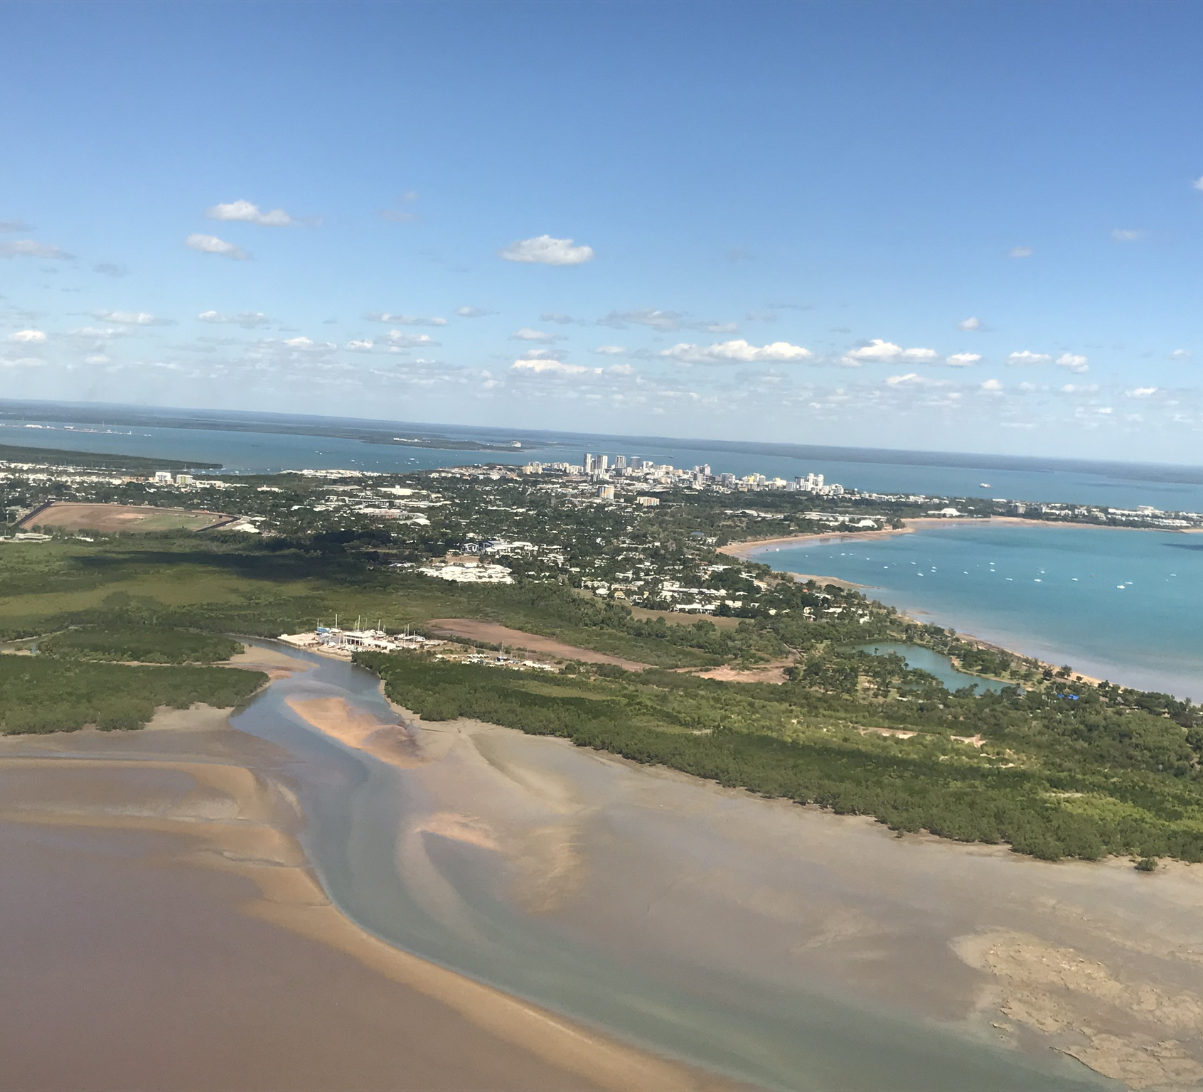
Darwin City
31m

Slide 8
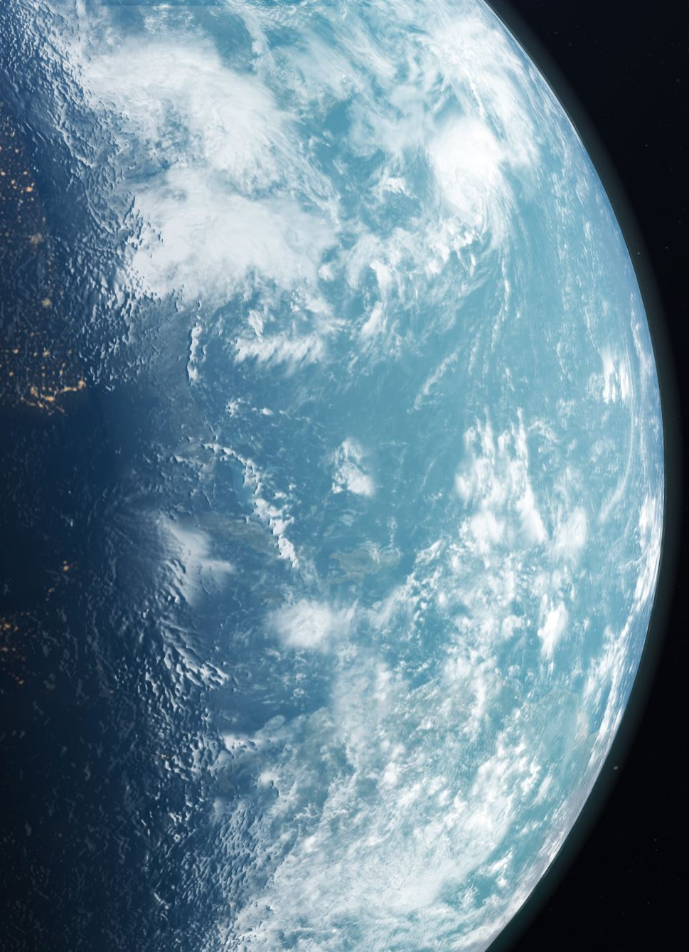
“The heavens declare the glory of God; the skies proclaim the work of his hands. Day after day they pour forth speech; night after night they reveal knowledge.” Psalm 19:1-2

