Slide 1



Really hot and cold places
Using integers to Explore God’s amazing creation

Slide 2
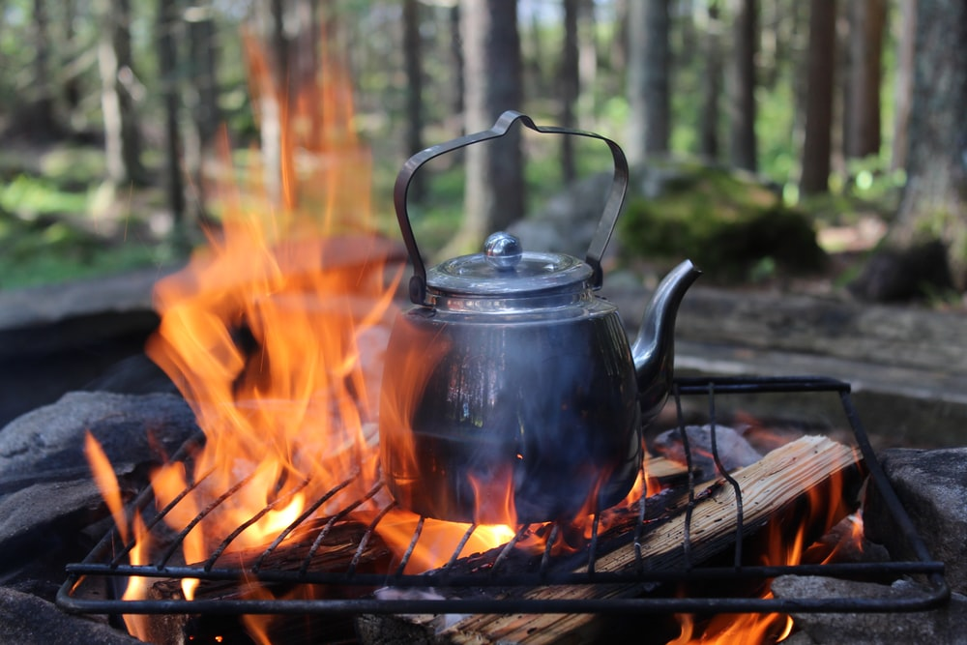

Water boils at ${100}^{o}$C

Slide 3
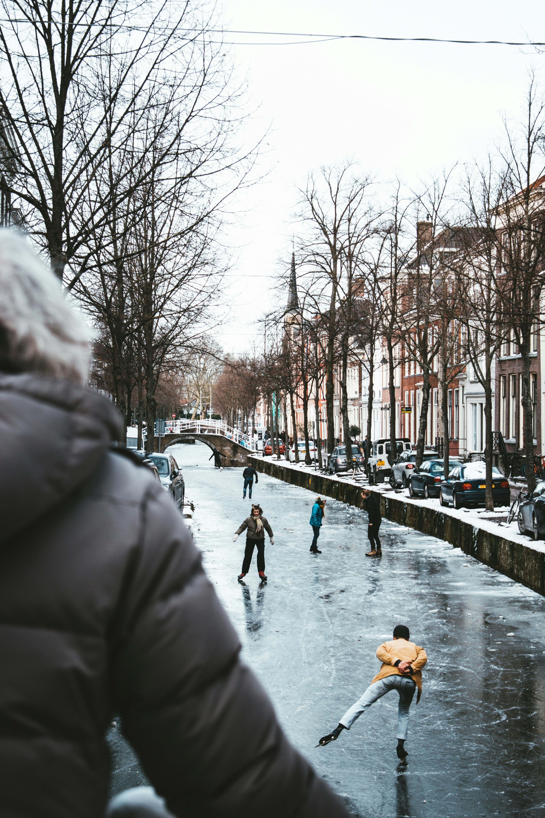
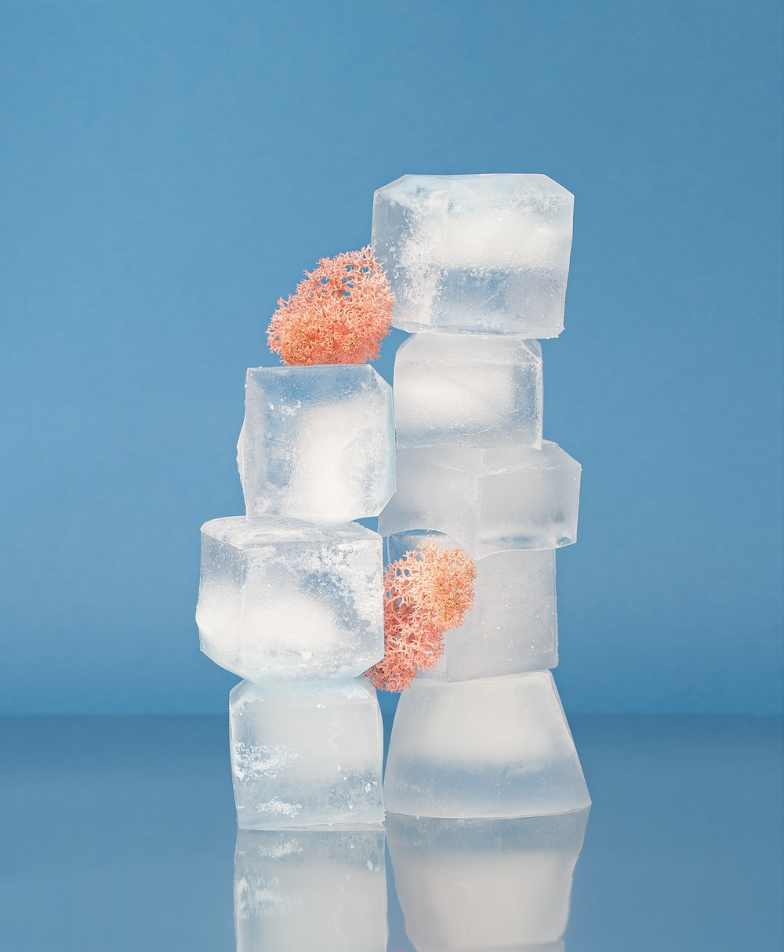

Water freezes at $0^{0}C$

Slide 4
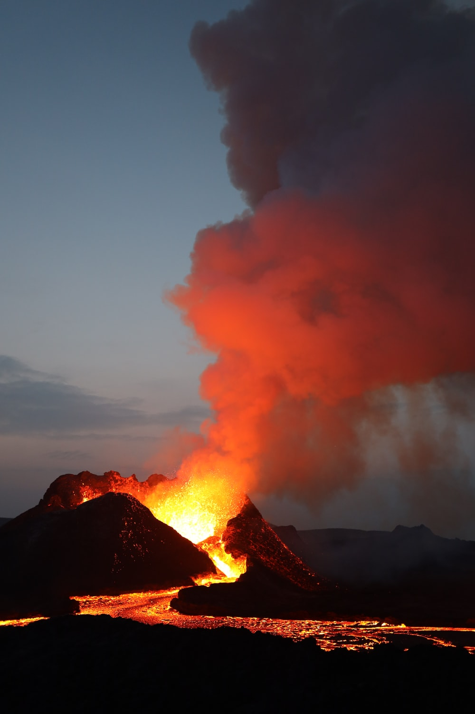

Volcano
Lava – about ${1000}^{0}C$

Slide 5
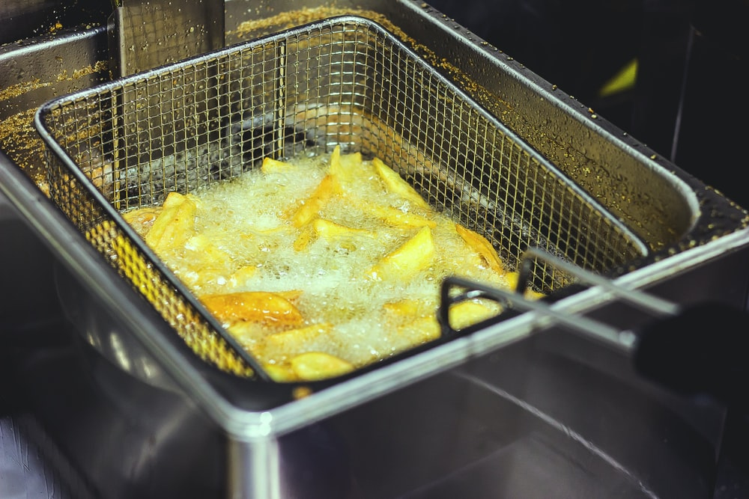

Chips frying
Recommended:
about ${180}^{0}C$

Slide 6
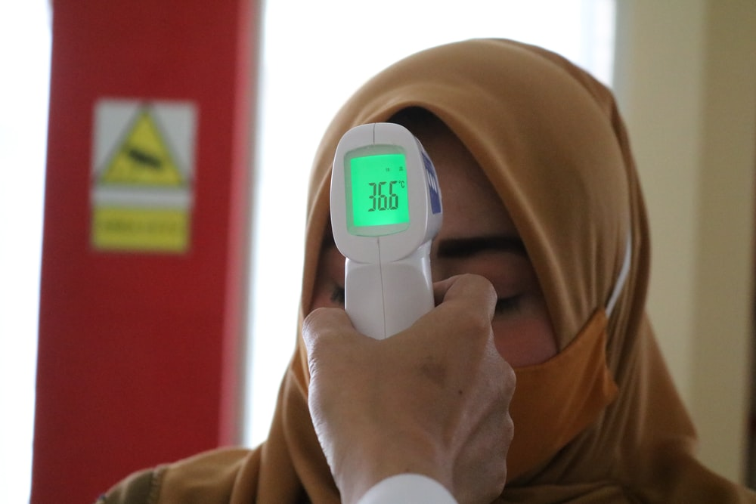

Body temperature
About ${37}^{0}C$

Slide 7
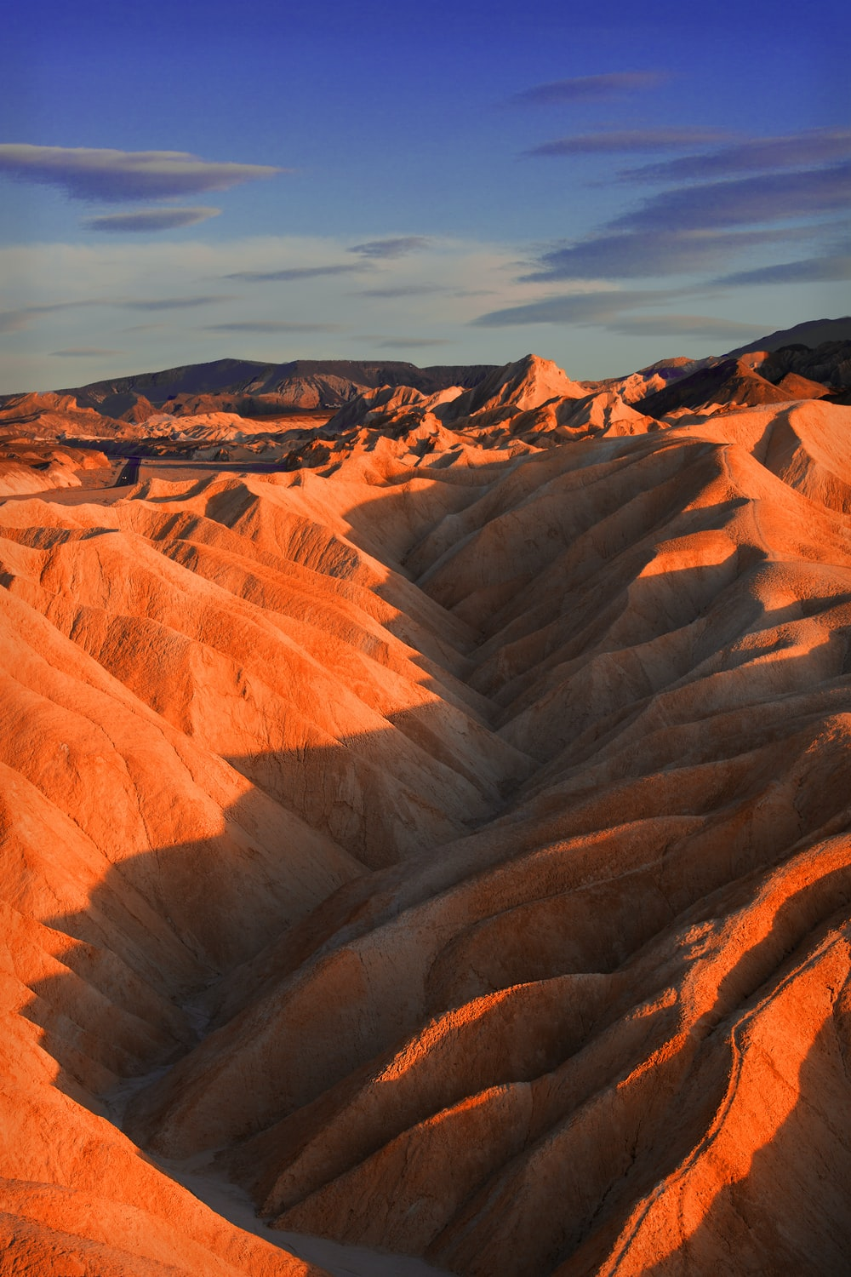

Death Valley – Hottest place on earth!
10th July 1913
$${56.7}^{0}C$$

Slide 8
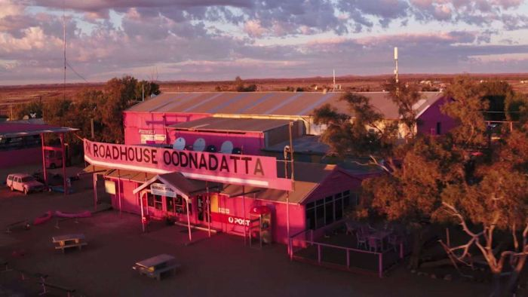
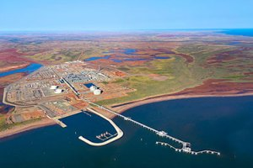
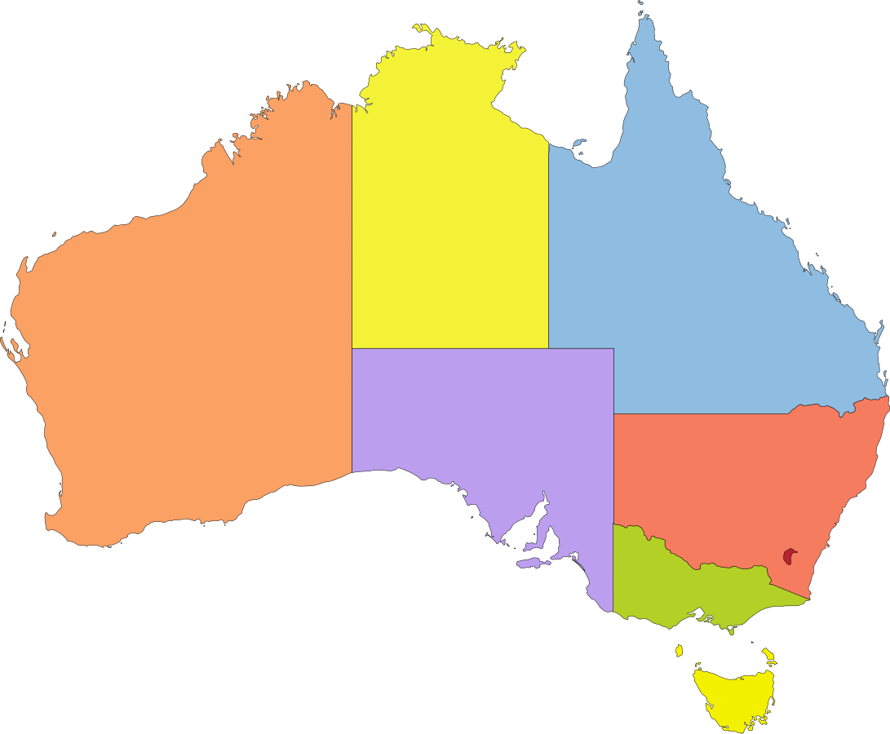


Hottest place in Australia
Onslow ${50.7}^{0}C$
Oodnadatta ${50.7}^{0}C$
13th January 2022
2nd January 1960

Slide 9
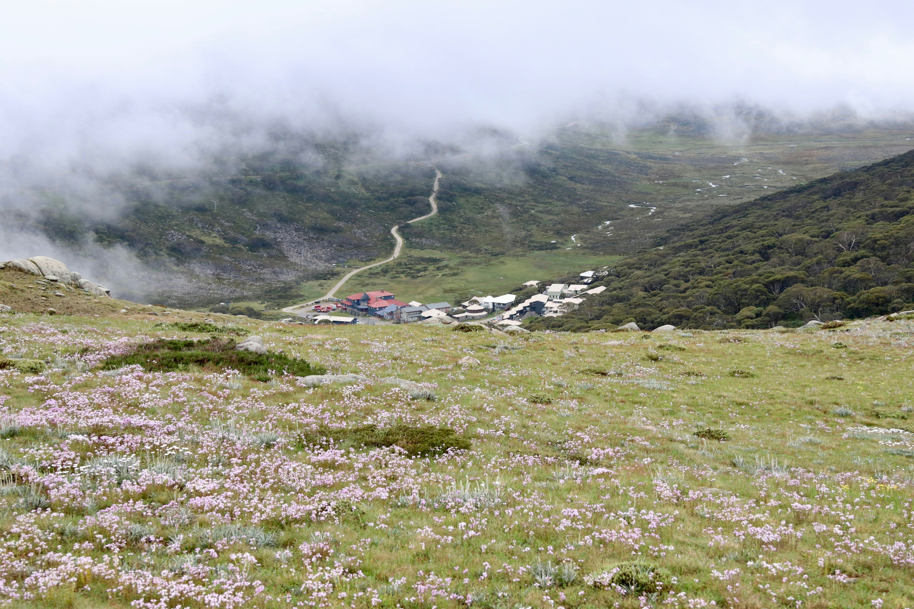

Coldest place in Australia
Charlotte Pass $−{23}^{0}C$
29th June 1994

Slide 10
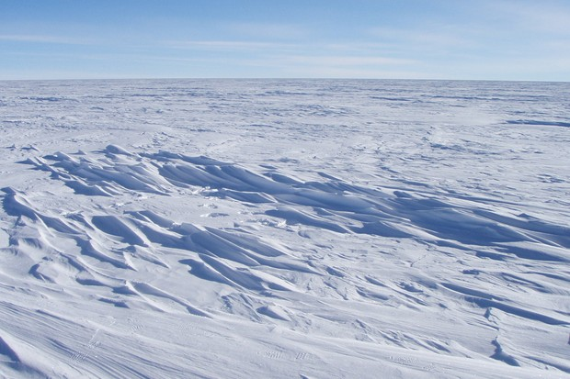
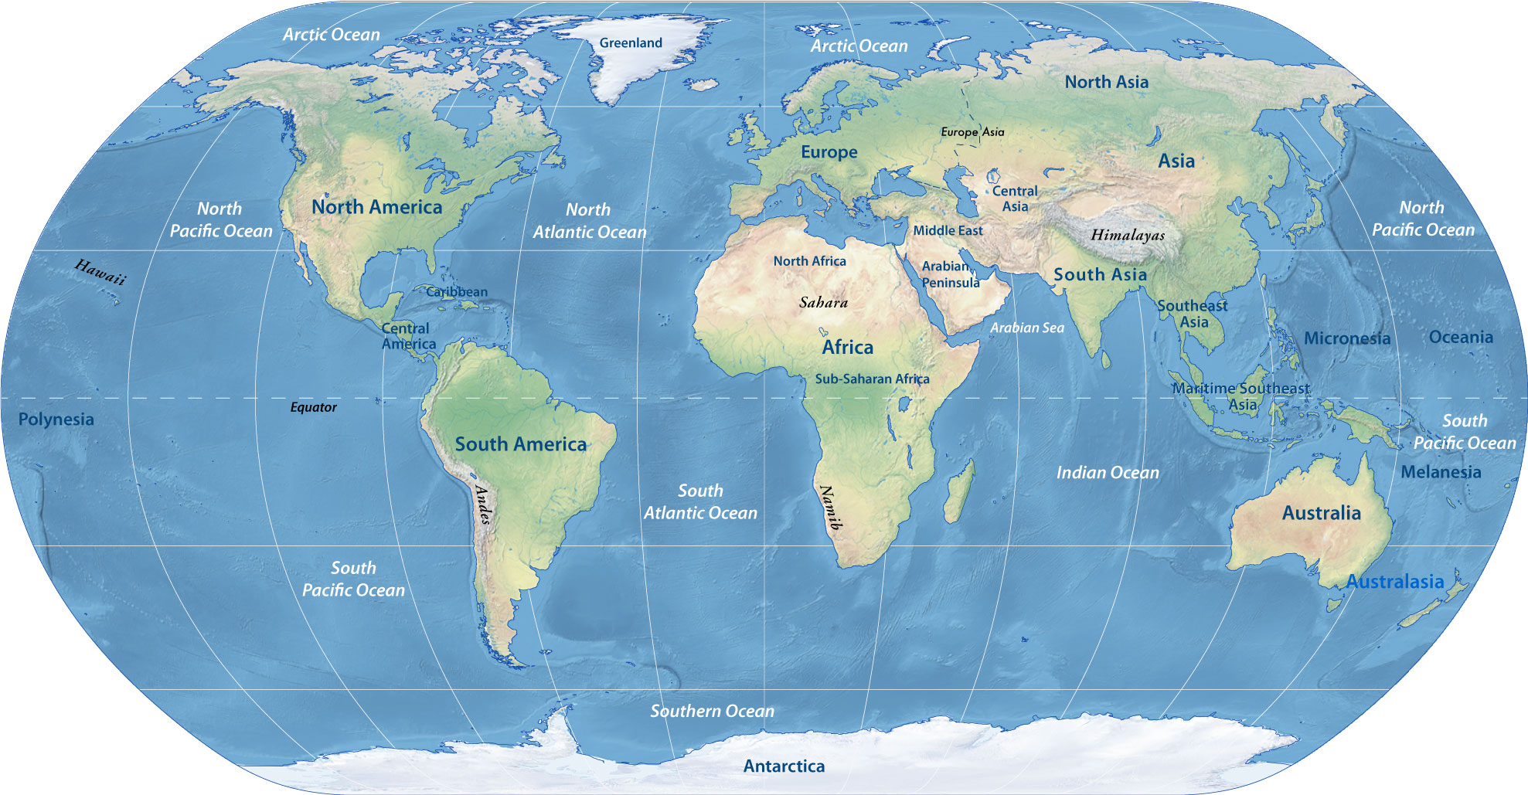

Coldest place on earth
Dome Fuji Antartica$−{94}^{0}C$

Slide 11
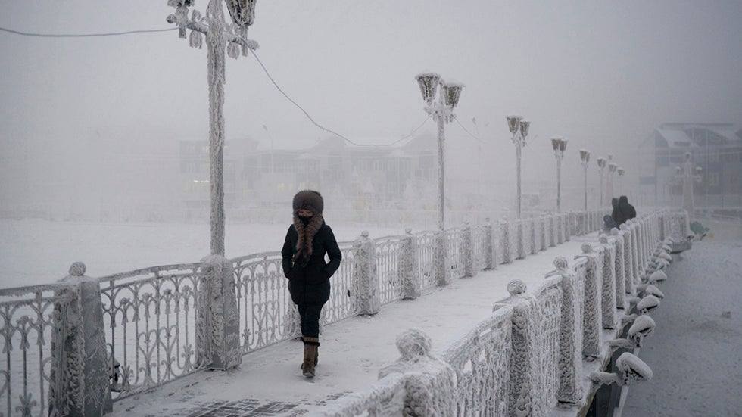
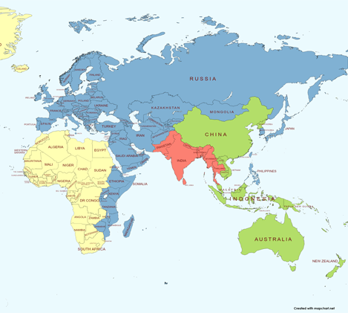
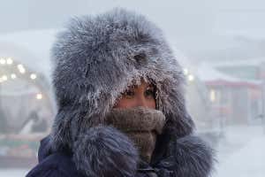

Coldest city in the world
Yakutsk Russia ${−71.2}^{0}C$

Slide 12
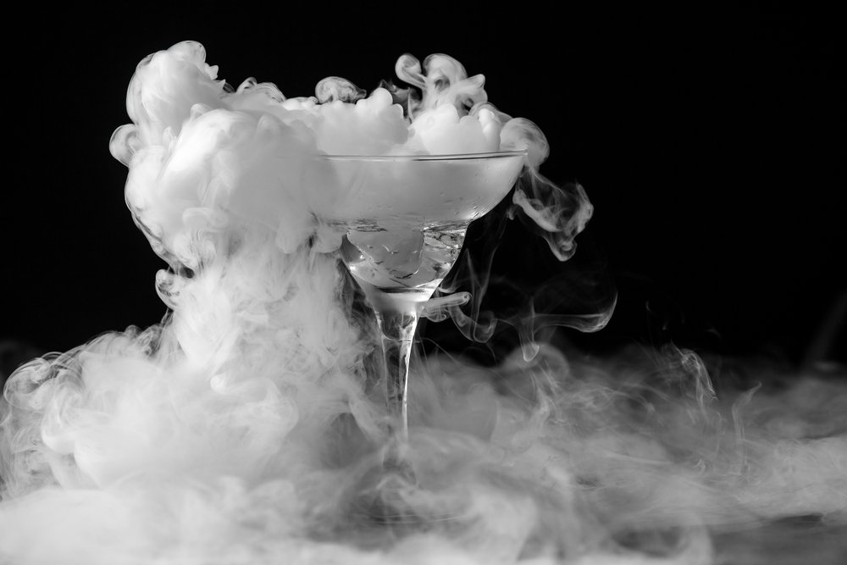

Dry ice
Becomes gas at $−78.5C$

Slide 13
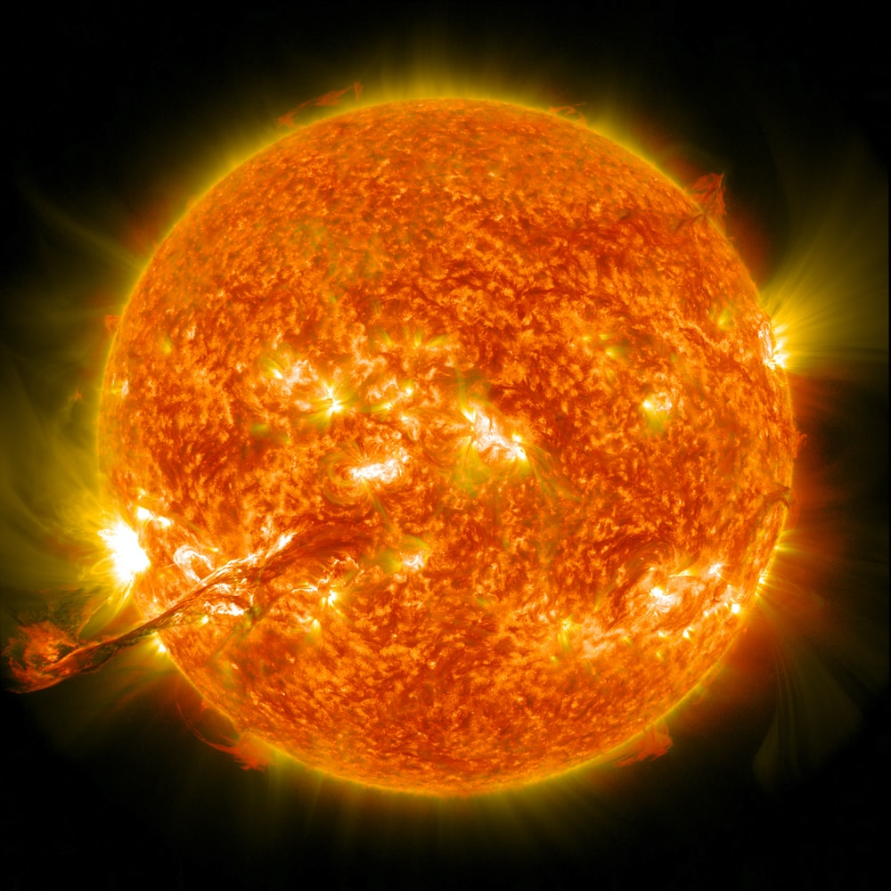

Sun’s surface ${6000}^{o}$C

Slide 14
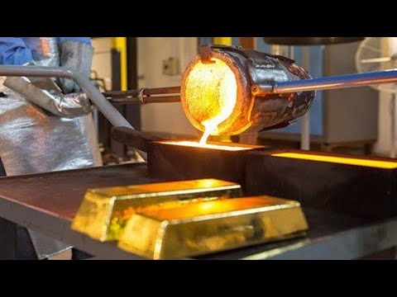

Gold melts at ${1064}^{o}$C

Slide 15
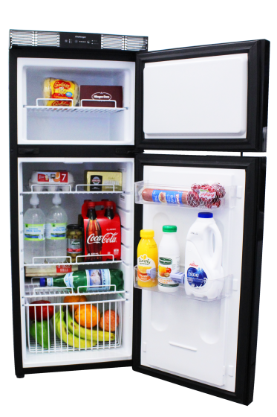


Keeping food fresh
Freezer $−{18}^{o}C$
Fridge $3^{o}C$

Slide 16
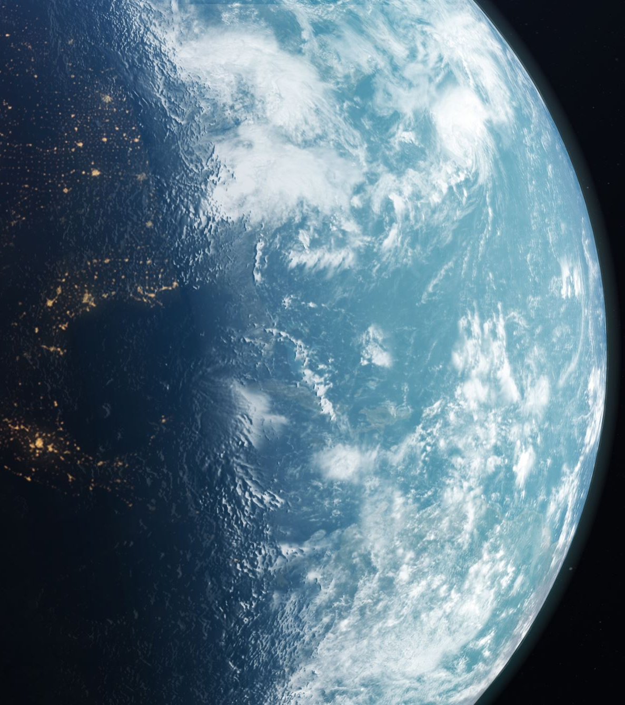
“The heavens declare the glory of God; the skies proclaim the work of his hands. Day after day they pour forth speech; night after night they reveal knowledge.” Psalm 19:1-2

