Slide 1



Using statistics to evaluate Shalom

Slide 2
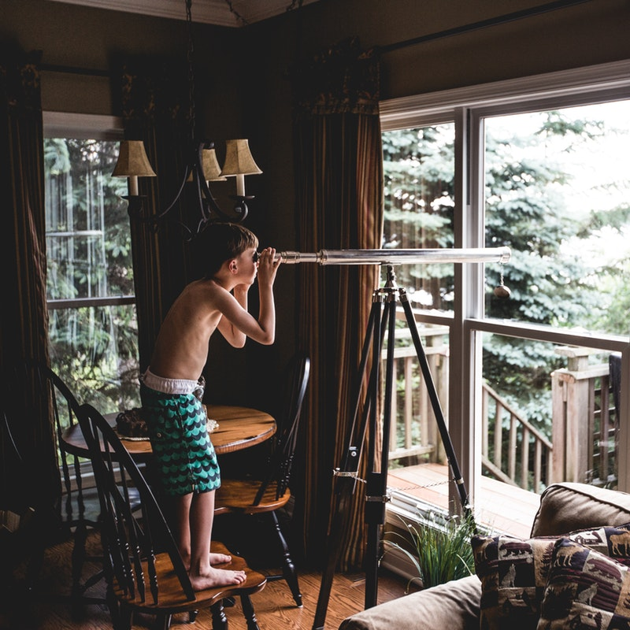
Jesus said “I have come that you may have life and have it to the full”. John 10:10
Notes:
Photo: Teddy Kelley

Slide 3
God is a relational God – before he created us – there was a ‘dance’ going on between God the Father, the Son and the Holy Spirit.
Deep relationship.
He then created man – for deep relationship with him and with each other.
There was Shalom
Notes:
Photo: Jude Beck

Slide 4

Shalom
With God
With each other
With ourselves
Notes:
Photo: Cynthia Magana

Slide 5

But humans sinned and broke that deep, open relationship with God, and with each other …
Blamed each other… were self-conscious around each other…
Notes:
Photo: Gijs Coolen

Slide 6

Good news
The good news is that God has shown a way to rebuild those communities through Jesus.
Knowing Jesus brings a life of “shalom” (deep peace and well being with God, with each other and with yourself).
We are part of building those communities while on earth… one day perfected with the New Heaven and the New Earth!
Notes:
Photo: Helena Lopes

Slide 7

What has this got to do with Maths?
We have looked at how patterns can lead us to worship God
But Maths gives us a powerful tool to use to evaluate ourselves and our communities
Lets stand back and look at how we are going in the area of Shalom with ourselves…
And Shalom in our communities
Notes:
Photo: Mark-Olivier Jodoin

Slide 8

We will specifically look at these issues around screen usage
When or how are screens contributing to Shalom?
When or how are screens getting in the way of Shalom?
Notes:
Photo: Steinar Engeland

Slide 9

Romans 12:1-2 Msg
¹⁻² So here’s what I want you to do, God helping you: Take your everyday, ordinary life—your sleeping, eating, going-to-work, and walking-around life—and place it before God as an offering. Embracing what God does for you is the best thing you can do for him.
Don’t become so well-adjusted to your culture that you fit into it without even thinking.
Instead, fix your attention on God. You’ll be changed from the inside out. Readily recognize what he wants from you, and quickly respond to it. Unlike the culture around you, always dragging you down to its level of immaturity, God brings the best out of you, develops well-formed maturity in you.
Notes:
Photo: Tohm, B.
What parts of our culture does this photo signifiy? What is good? What is not good?

Slide 10
Using statistics to evaluate Shalom

