Slide 1


Wealth: Being wise with God’s abundance

Slide 2
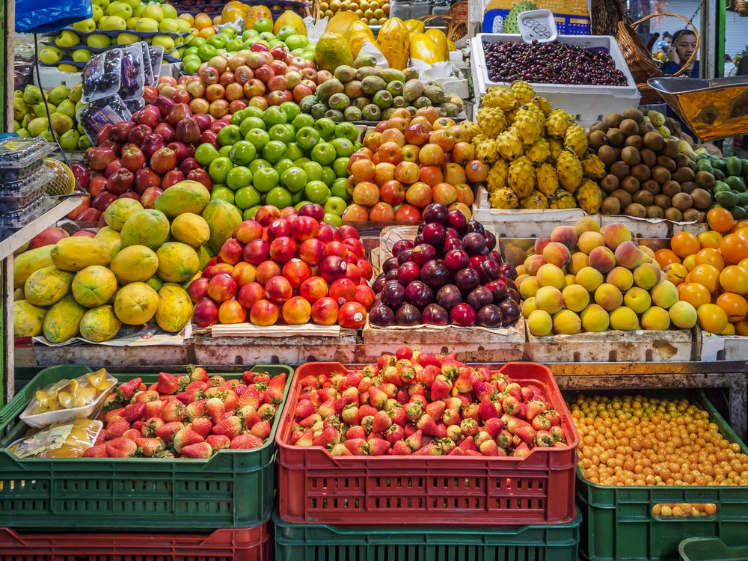
Is there anything wrong with having a lot?

Slide 3

God planned for us to enjoy the beauty, abundance and fruitfulness of creation.
In the idyllic setting of the Garden of Eden, the first humans found a rich, fertile place, and were intended to prosper in every sense.
God provides an abundance of resources and means for humans to flourish.
Genesis 1,2; Deut. 8:7-9

Slide 4

But what went wrong?

Slide 5
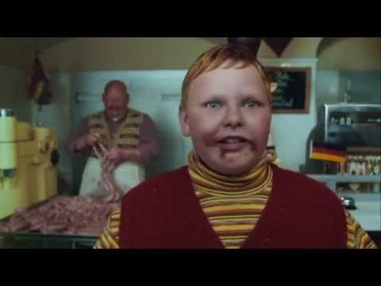
When is it good to have a lot?
When is it bad to have a lot?
https://www.youtube.com/watch?v=4EF1zYFHbus

Slide 6

Why do you think people desire to be "wealthy"?
Do you think being wealthy brings happiness and fulfilment?

Slide 7
Matthew 6:19-21 “Don’t hoard treasure down here where it gets eaten by moths and corroded by rust or—worse!—stolen by burglars. Stockpile treasure in heaven, where it’s safe from moth and rust and burglars. It’s obvious, isn’t it? The place where your treasure is, is the place you will most want to be, and end up being.”

Slide 8

How do banks make a profit?
Where does the profit go? Who gets it?
Can you think of a different way for society to lend and borrow money?
How would you deal with risk?
If anyone is poor among your fellow Israelites in any of the towns of the land the Lord your God is giving you, do not be hardhearted or tight fisted toward them. Rather, be openhanded and freely lend them whatever they need.
Deuteronomy 15:7-8
Notes:
Photo: O. Eletu

Slide 9

What else does the Bible say?
At the end of every seventh year, cancel all debts. This is the procedure: Everyone who has lent money to a neighbor writes it off. You must not press your neighbor or his brother for payment: All-Debts-Are-Canceled—God says so. You may collect payment from foreigners, but whatever you have lent to your fellow Israelite you must write off.
Deuteronomy 15:1-3 The Message
Notes:
Photo: N. Steeman

Slide 10
Another model…
‘In this Year of Jubilee everyone is to return to their own property.
‘If you sell land to any of your own people or buy land from them, do not take advantage of each other. You are to buy from your own people on the basis of the number of years since the Jubilee. And they are to sell to you on the basis of the number of years left for harvesting crops. ¹When the years are many, you are to increase the price, and when the years are few, you are to decrease the price, because what is really being sold to you is the number of crops. ¹Do not take advantage of each other, but fear your God. I am the Lord your God.
Leviticus 25:13-17

Slide 11
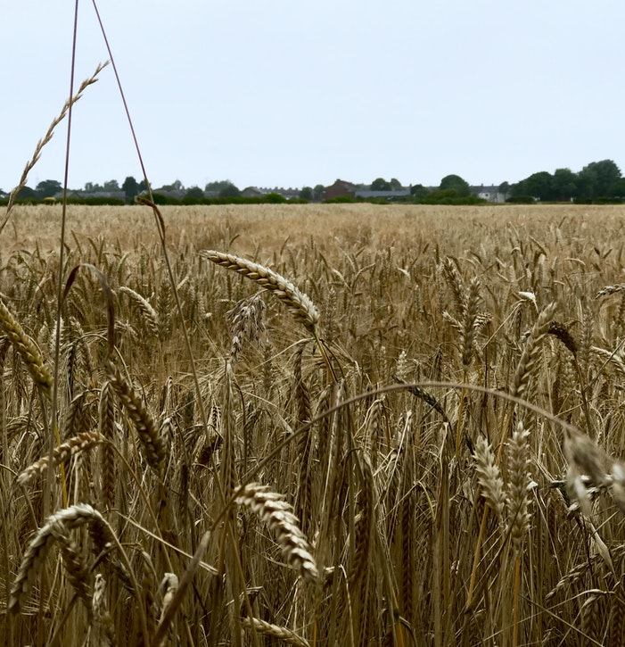
The model of the early church…
³² All the believers were one in heart and mind. No one claimed that any of their possessions was their own, but they shared everything they had.³³ With great power the apostles continued to testify to the resurrection of the Lord Jesus. And God’s grace was so powerfully at work in them all³⁴ that there were no needy persons among them. For from time to time those who owned land or houses sold them, brought the money from the sales ³⁵ and put it at the apostles’ feet, and it was distributed to anyone who had need.
Acts 4:32-35
Notes:
Photo: K. Richards

Slide 12


You are the future “Culture Shapers”
An understanding of this topic will help you evaluate your cultural context, discern its errors and it's virtues, and seek to 'shake and shape' it for the Kingdom.

