Slide 1


Geometric Patterns in Nature
Is this by chance?

Slide 2
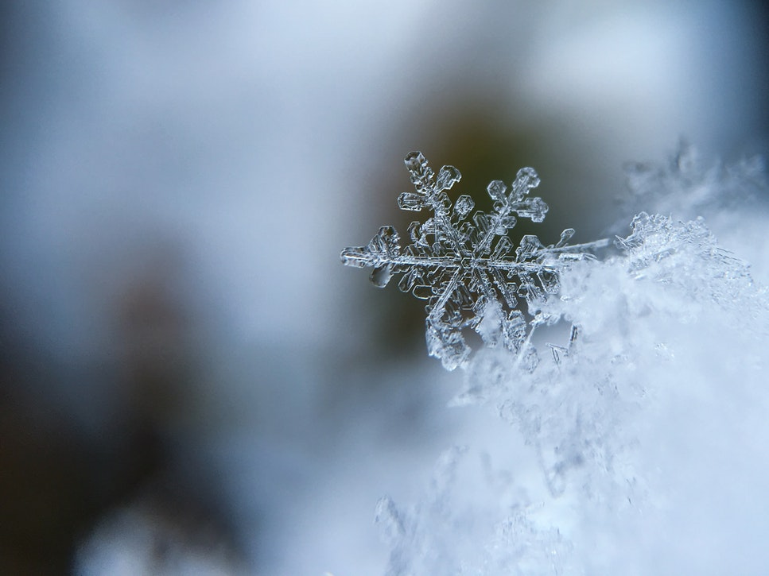
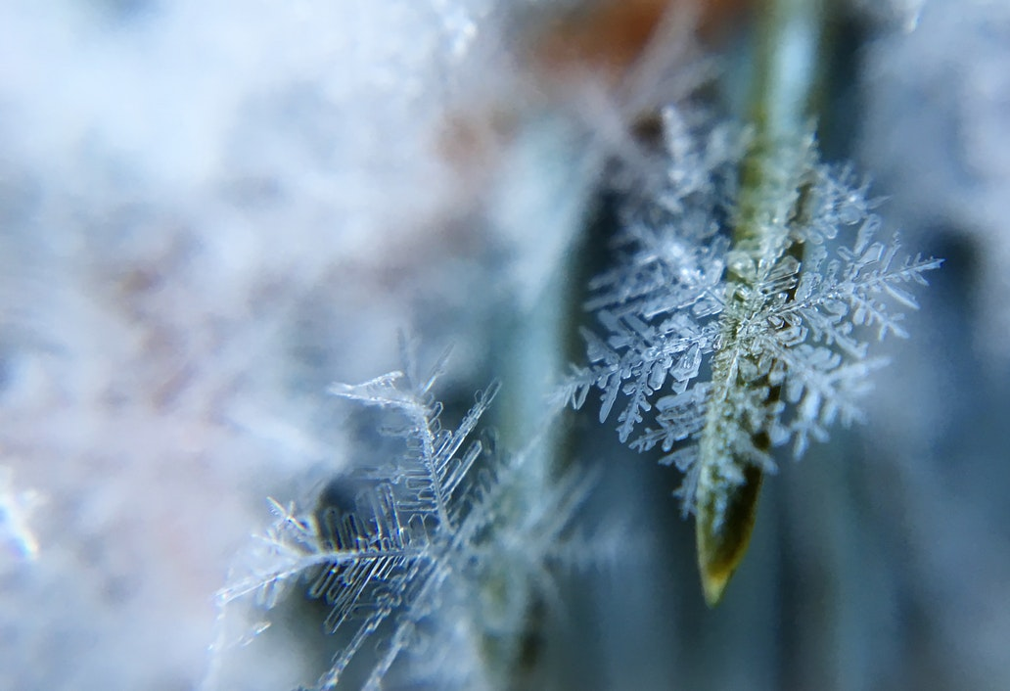
What makes snowflakes so beautiful?
Why did God do this?
Notes:
Burden, A.
Symmetry, harmony, pleasing to the eye.

Slide 3
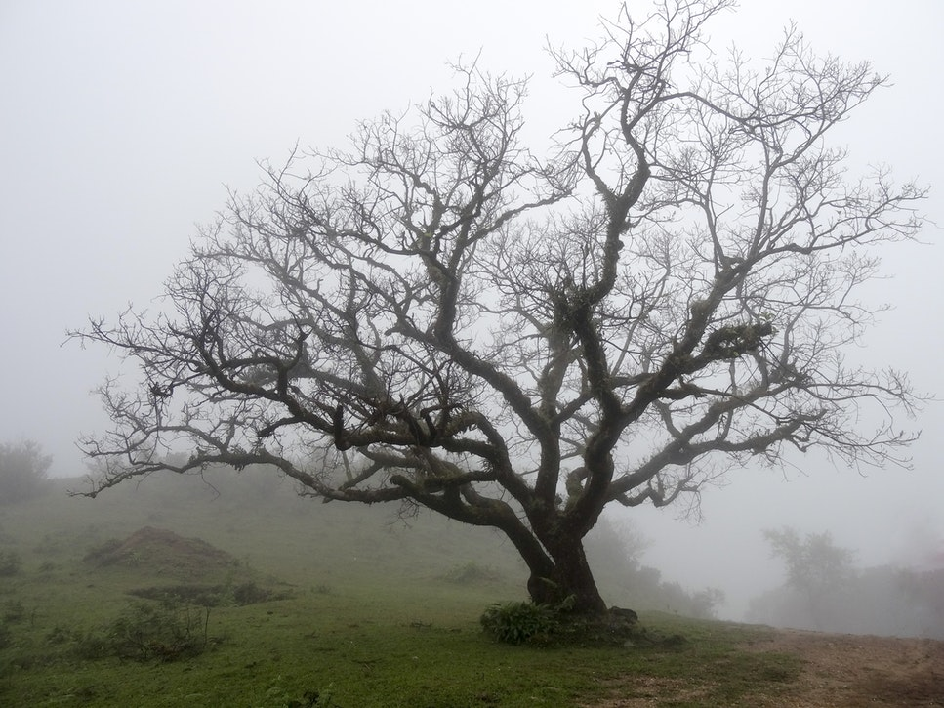
How does a tree point to infinity?
Notes:
Kummur, A.
Fractals – in ‘perfect’ conditions, with ‘unlimited growth’!

Slide 4
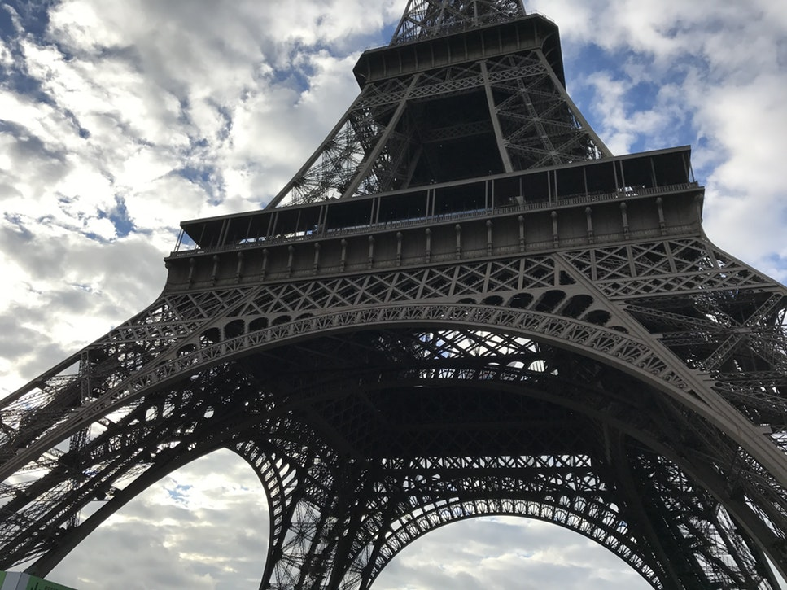
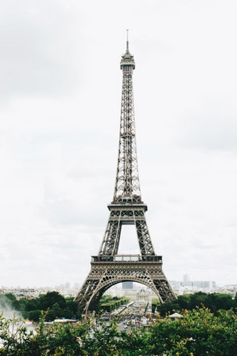
What makes the Eiffel tower so beautiful and recognisable?
What was considered in the design?
Where did man get this talent for creative art?
Notes:
Yanase M
Delanoix A
Gan C

Slide 5
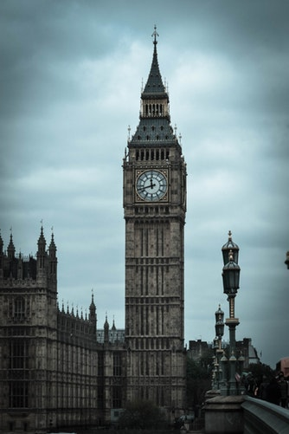
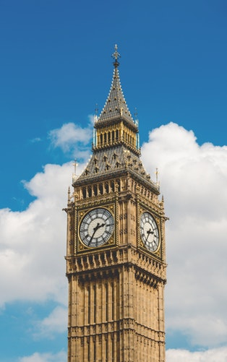
What makes Big Ben in London so beautiful and recognisable?
What was considered in the design?
Where did man get this talent for creative art?
Notes:
Be, H.
Clever visuals

Slide 6
Fractals

Slide 7
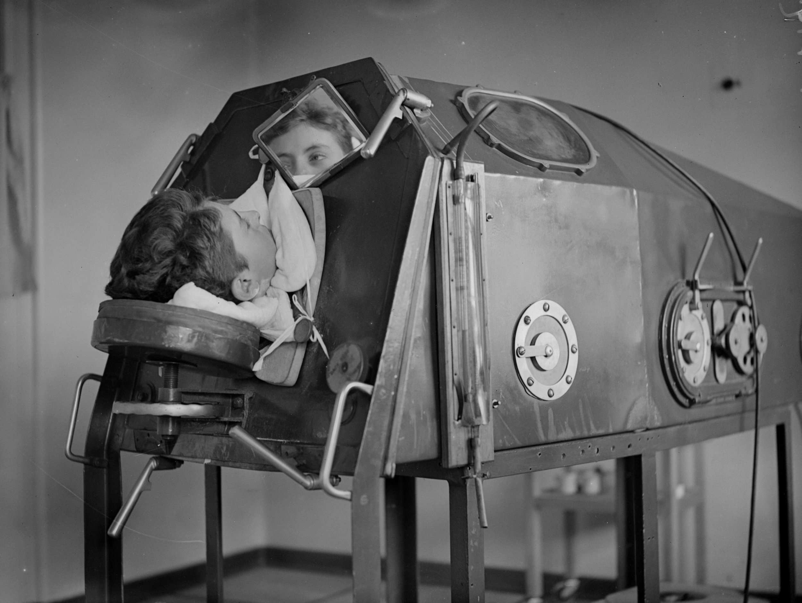
Notes:
Photo: https://www.newsweek.com/how-does-iron-lung-work-polio-survivor-last-us-1083104
Have this slide open when students arrive
Sit with this slide open for a while. Tease out ideas such as: I wonder who this person is? “I wonder what their life would be like”? Share knowledge and stories of lung machines. Draw out the importance of lungs.
Intended as a hook to draw participants into the presentation; causing them to wonder where this is going; create interest to find out

Slide 8
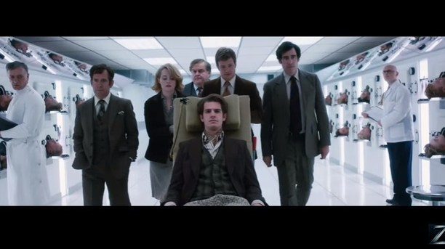
Breath
Trailer
Notes:
Show clip
Lungs – part of God’s design for the most basic function of ‘life’ in our human bodies (another ‘attention grabber’ to consider this idea)

Slide 9
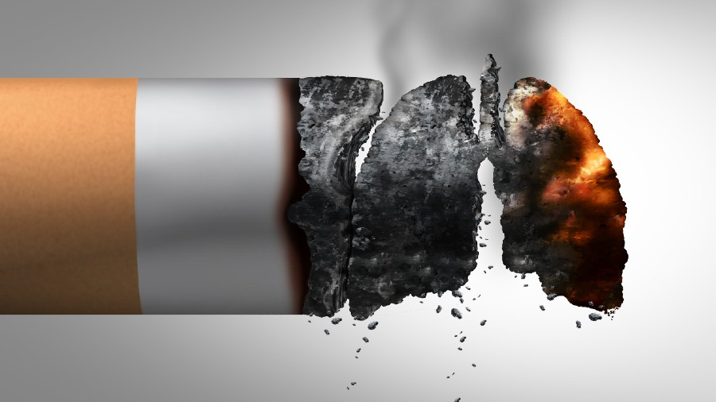
Lungs
Breathing
The very essence of life!
Chat
Notes:
Thoughts that come to mind when you see this slide?
What do you notice? What do your feel? What do you want to do? COVID has highlighted this amazing organ. We take for granted – the very breath of life. Almost desensitised to photos like this at the moment.

Slide 10
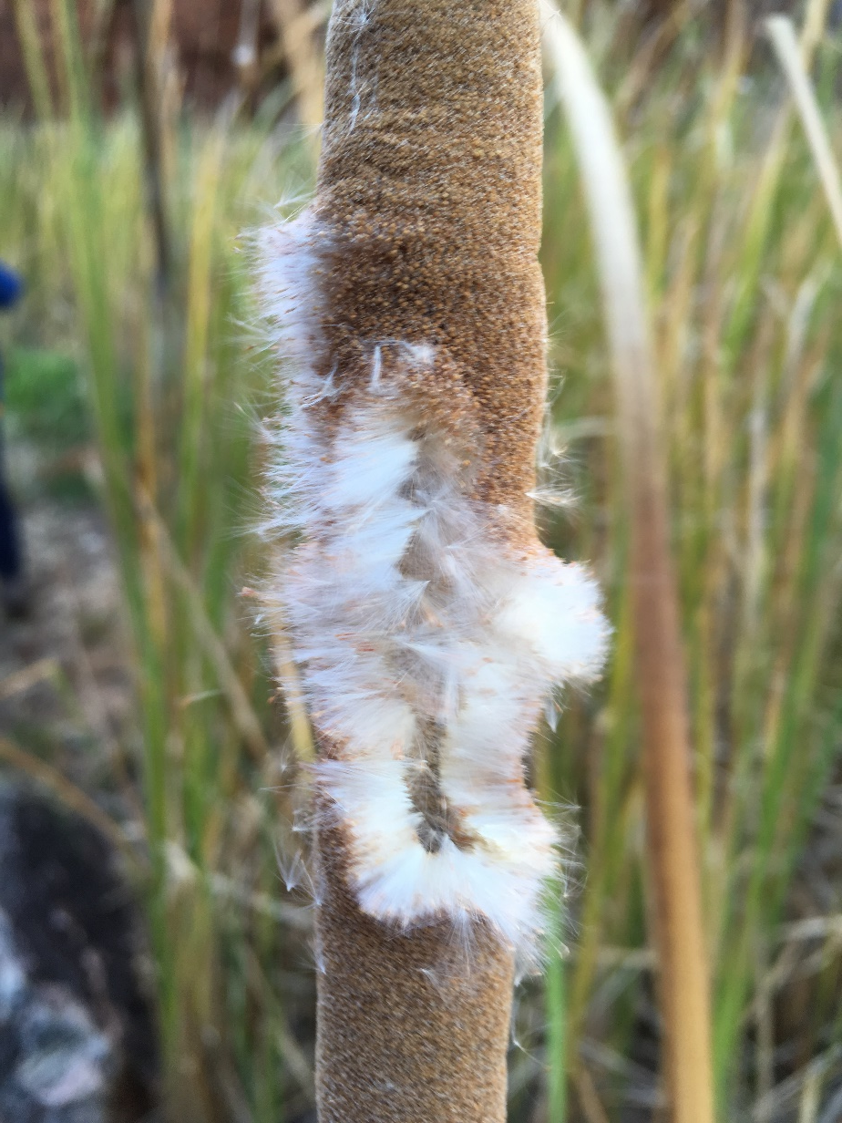
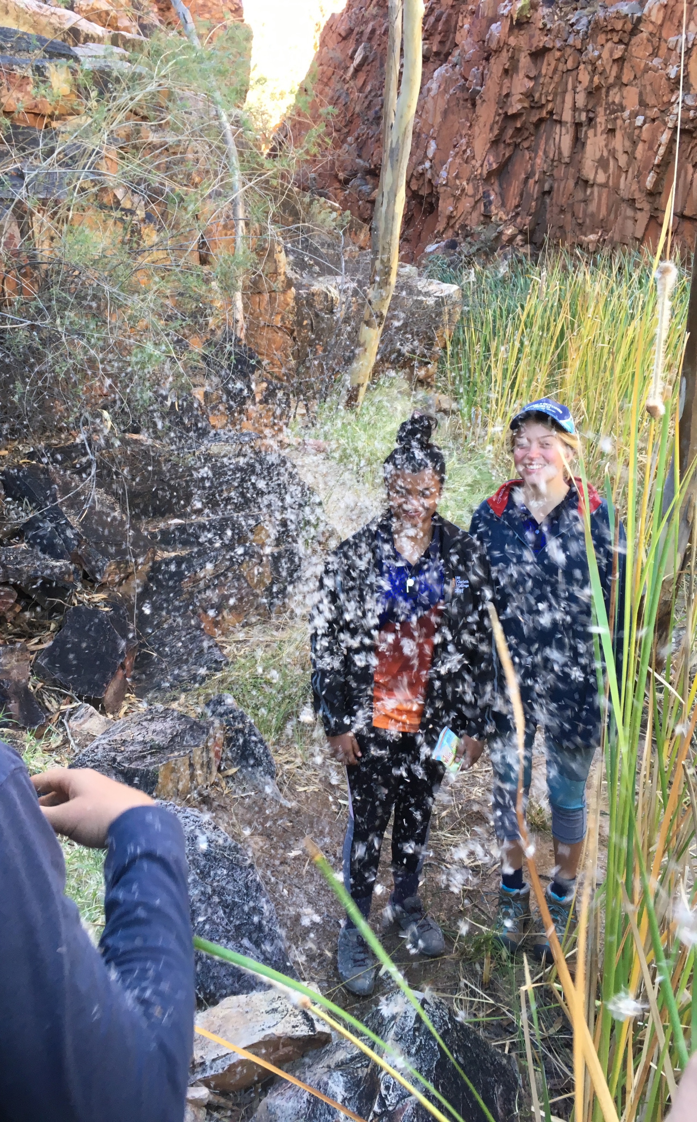

Draw some lungs!
Notes:
On the first page: have a go at drawing lungs. Hopefully someone will include the idea of ‘trees branching’ – draw attention to this idea. If no one seems to be including this – quietly suggest the idea into the discussion that’s happening while everyone is drawing.
The intent is to have active participation, and not give room for passive participation, yet in a safe and accessible environment.
The alternative to this activity would be to have someone come up and draw lungs on the board – however this allows ‘students’ to remain passive.
Invite everyone to share (hold them up together – or go around and explain).
In a classroom you might invite ‘feedback’ and give time for improvement on drawings.
Photos: (L. Clarkson, 2019)

Slide 11
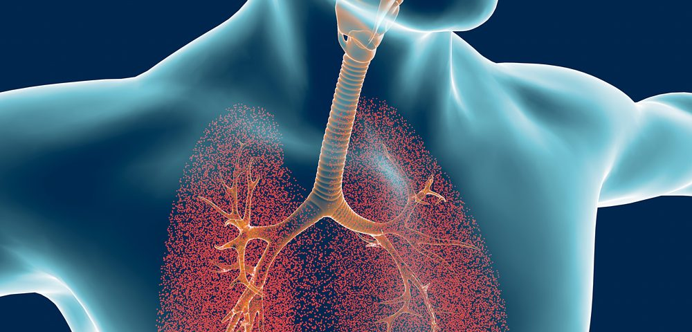
Notes:
One depiction of lungs

Slide 12
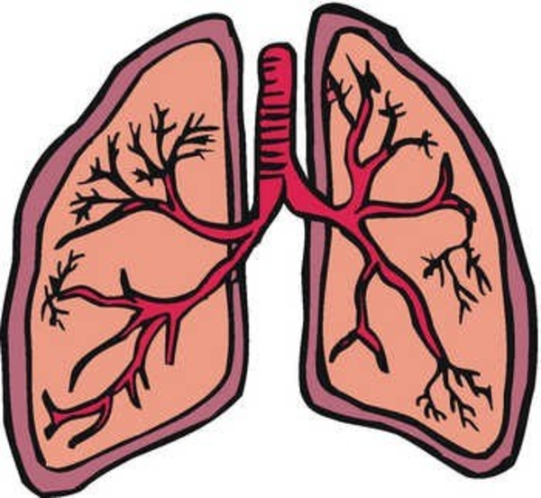
Bronchial Tree
The bronchi branch into smaller bronchi and then even smaller bronchioles.
These tiny tubes stretch out into every part of your lungs. Some, only the thickness of a hair.
About 30,000 bronchioles in each lung.
Each bronchiole tube ends with a cluster of small air sacs called alveoli (about 600 million) for air to pass through
Notes:
The brain; veins; trees; snowflakes; broccoli…
How are these the same? How are they different?

Slide 13
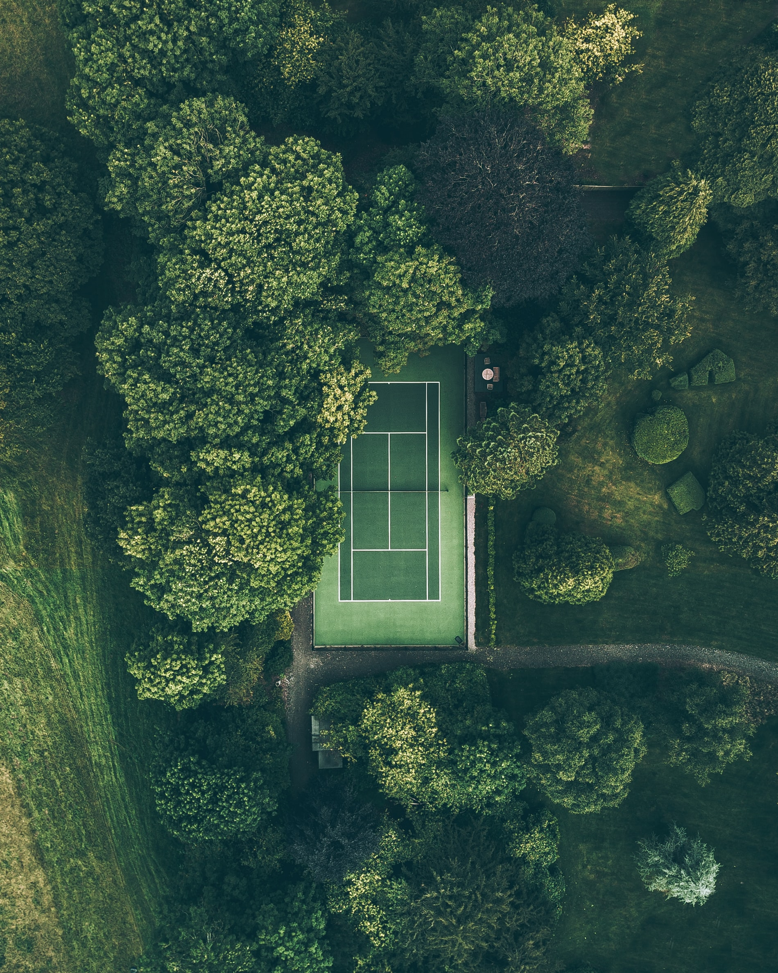
The volume of a pair of human lungs is only ~4 - 6 litres
however
The surface area is between 50 and 100 square meters.
That's about the same area as a tennis court!
Notes:
Photo: Ryan Searle

Slide 14
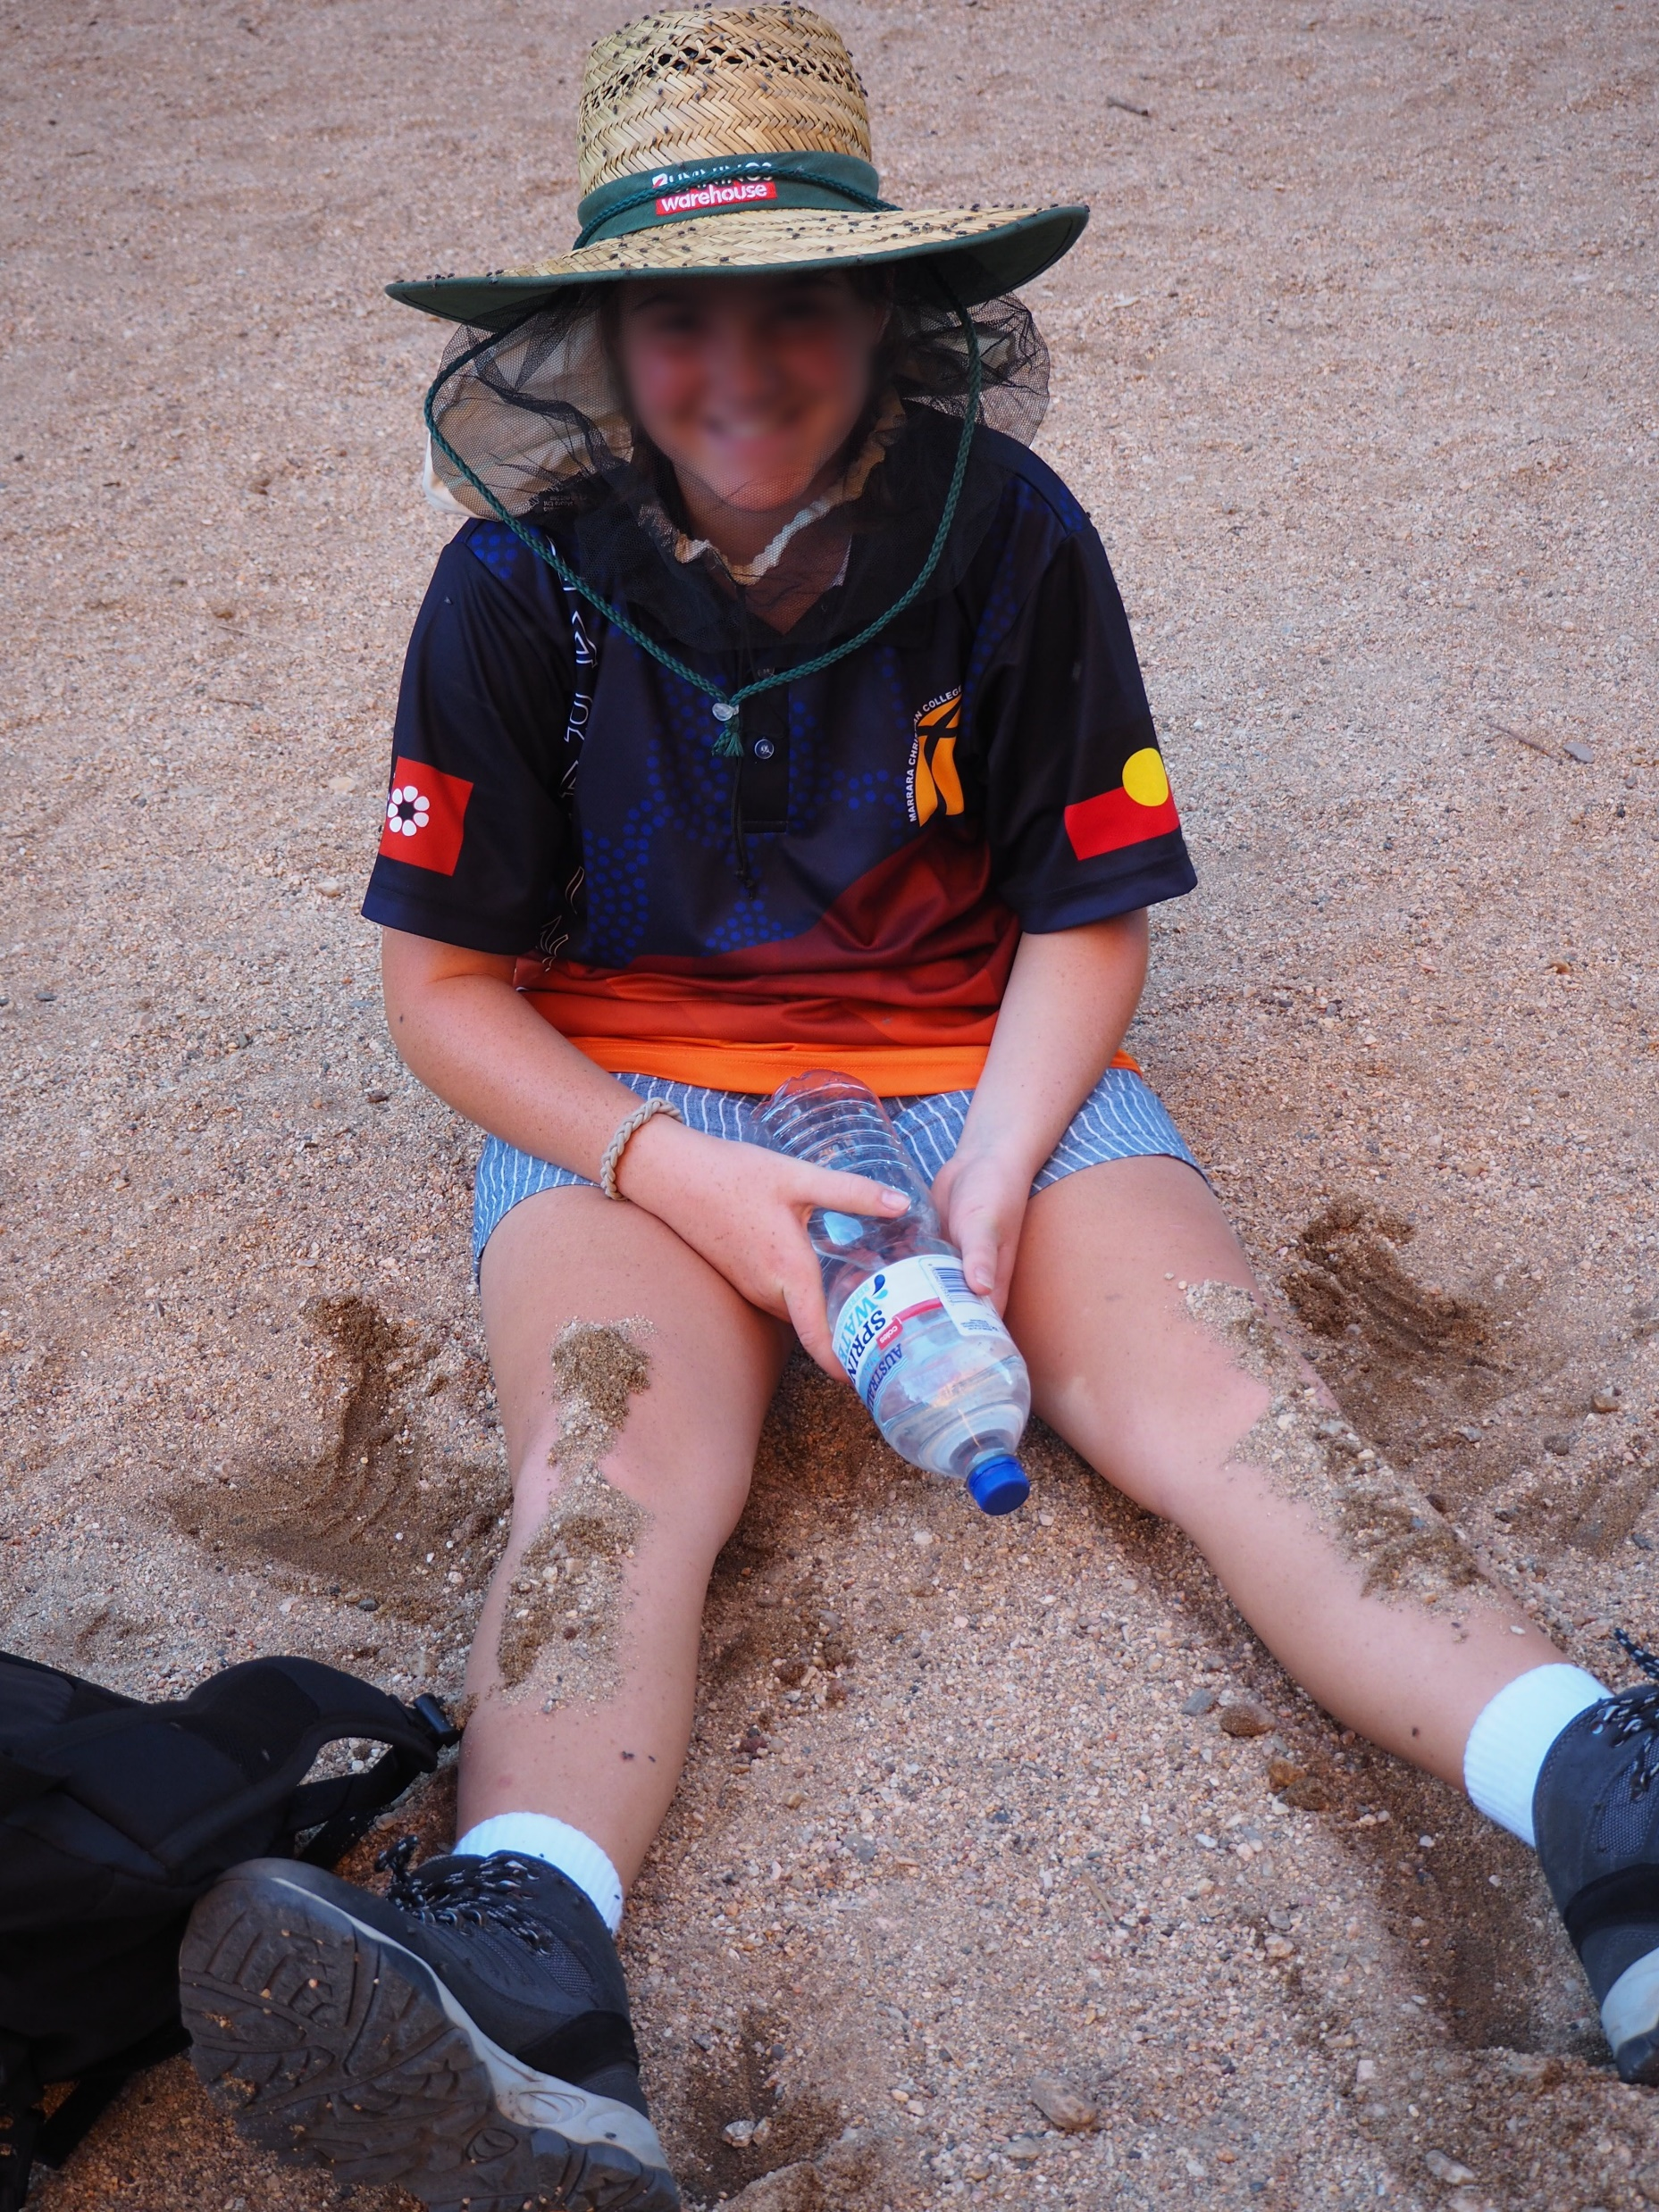
I praise you because of the wonderful way you created me.
Everything you do is marvelous!
Of this I have no doubt.
Psalm 139:14 CEV
Notes:
Photo: (R. Watson, 2019)

Slide 15
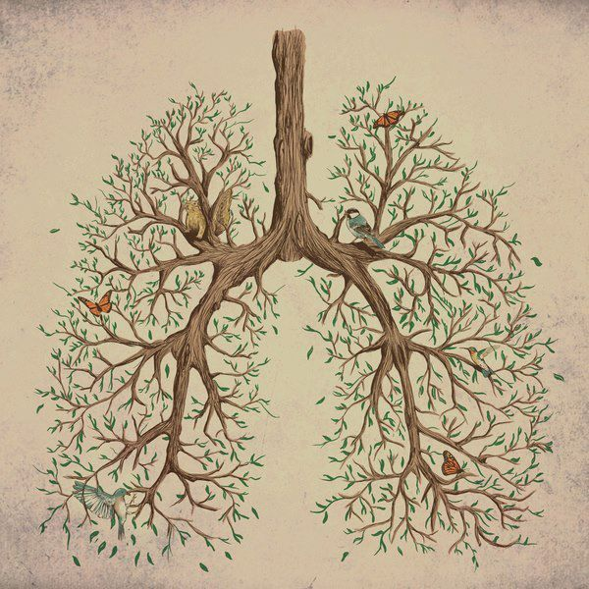
Fractals
Where else might you come across fractals in nature?
Chat
Notes:
Some interesting things to consider: ideas from: https://fractalfoundation.org/OFC/OFC-index.htm

Slide 16
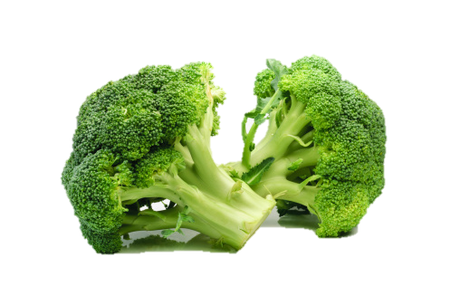
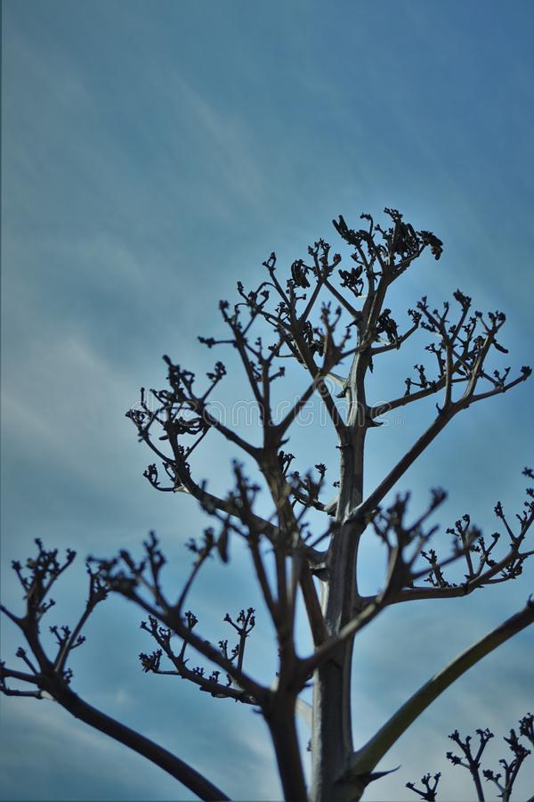
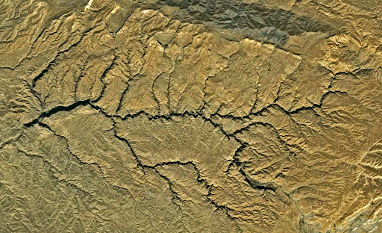
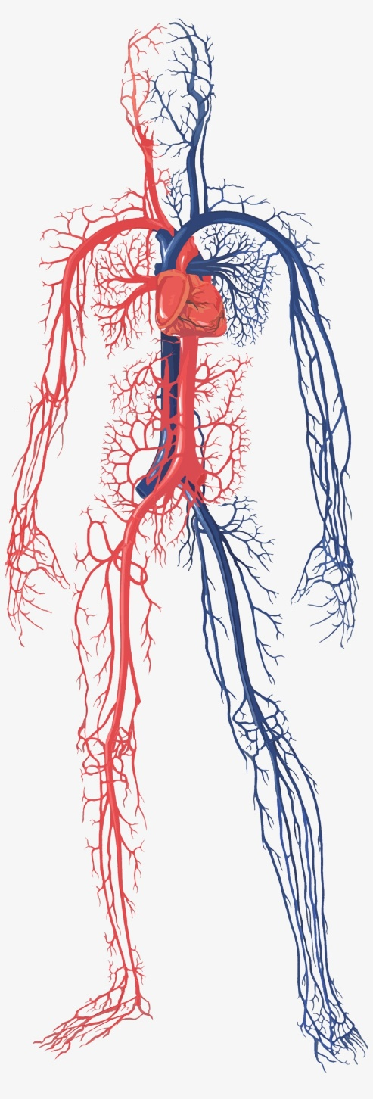
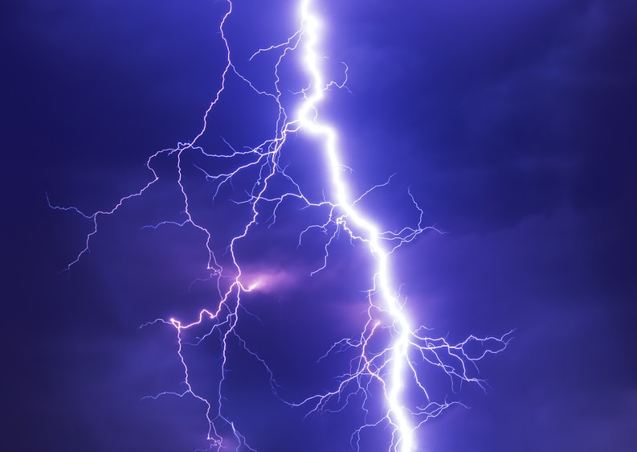

Slide 17
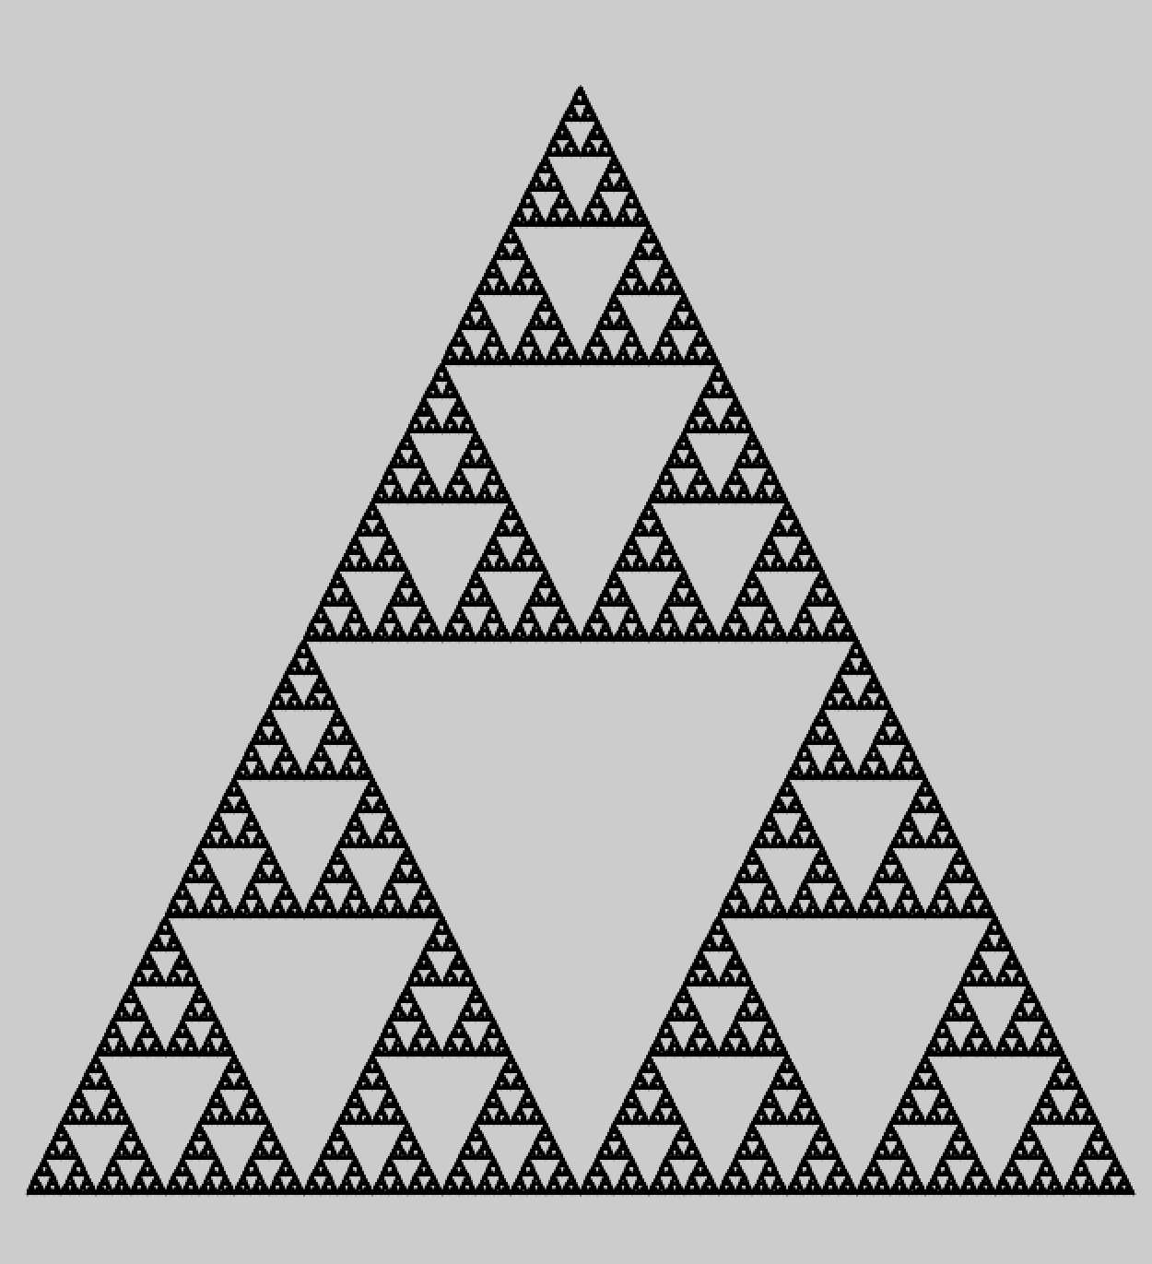
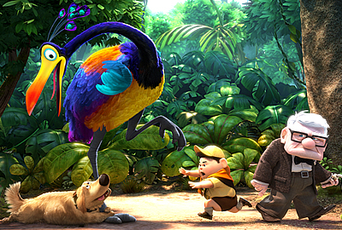
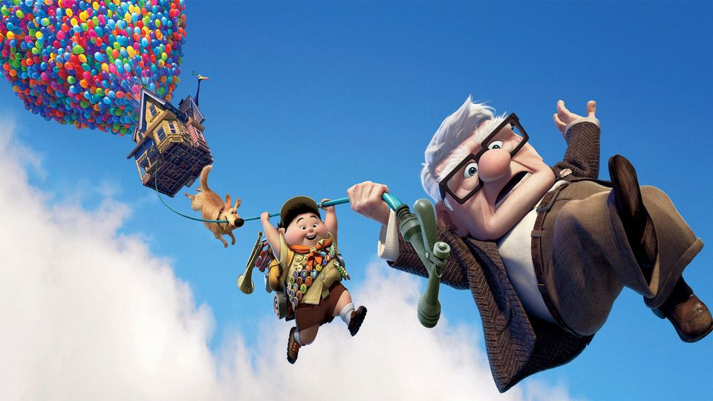
What does the movie “Up” have in common with the Sierpinski Triangle?
Notes:
Humans have taken the patterns which God built into nature and used these to create other ideas!
Pixar Animation studios

Slide 18
Both based on fractals!
Humans have take the patterns which God built into nature and used these to create other ideas.
Notes:
Humans have taken the patterns which God built into nature and used these to create other ideas!
Pixar Animation studios

Slide 19

“When I consider your heavens, the work of your fingers, the moon and the stars, which you have set in place, what is mankind that you are mindful of them, human beings that you care for them?” Psalm 8:3-4

Slide 20
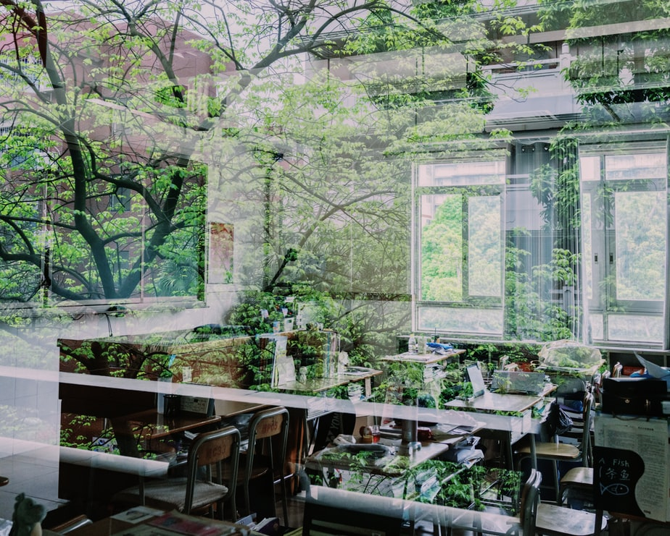
Geometric design – built into creation – which leads us to the worship God the creator
Notes:
Fractals: indices; infinity; growth; logarithms; proportion; similarity; geometry; surface area and volume; dimensions; optimisation; computer graphics; design etc.
One key idea is that fractals point to the infinity of the creator God
“Mathematics through the eyes of faith” (Bradley & Howell, 2011) has some interesting discussions and applications
The Code: Shapes chapter 4 (Childs, 2009) contains some beautiful examples
You could then continue with examples of how humans, made in God’s image, have taken the ideas of fractals to create other ideas, particularly art and design: have students spend 10 mins finding their favourite image that incorporates fractals; add a Bible verse or ‘speech bubble’; print them and hang them in the classroom
An exemplar activity/ assignment will be distributed either as a handout or as a downloadable link to take home (Appendix 1)
Photo: Lu

