Slide 1


Pythagoras
Home - Christian Mathematics Teachers

Slide 2
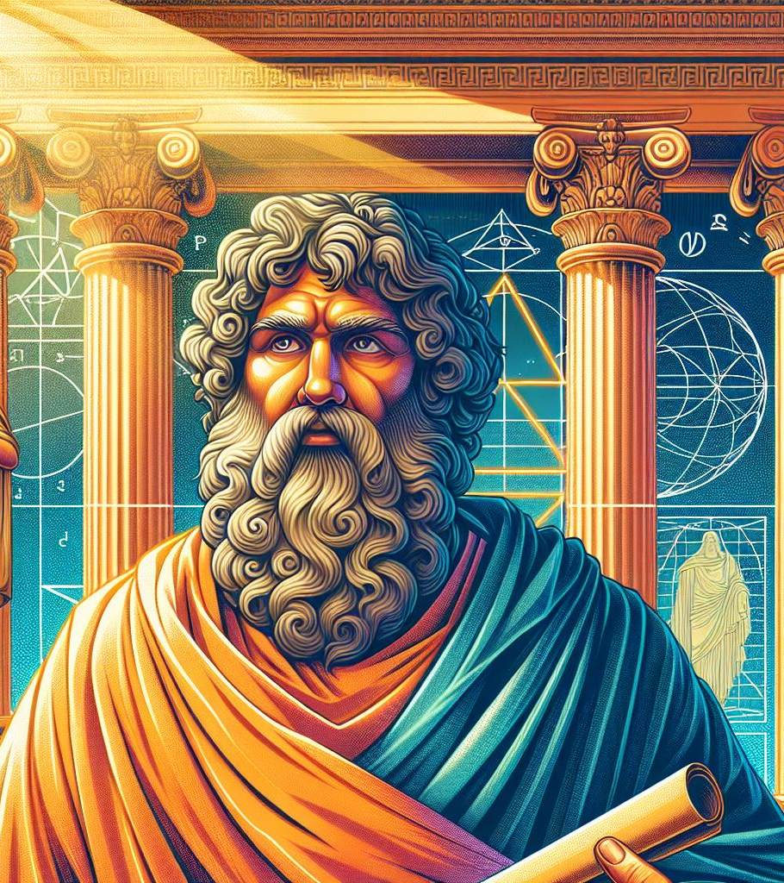
Believed that:
Numbers ruled the world
The whole universe could be explained by counting numbers

Slide 3

Pythagoras:
Marveled at the reliable and predictable mathematical patterns that exist in the universe
Identified that the world is in constant flux, but the geometric and numerical relationships don’t change
Hence ultimate reality consists of geometry and numbers
Therefore, numbers rule the universe!

Slide 4
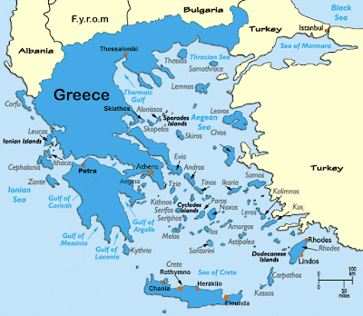
Pythagoras
Was Greek
Came from the Island of Samos
Lived around 500BC
  That’s 2500 years ago!
Travelled a lot (e.g. to Egypt)

Slide 5
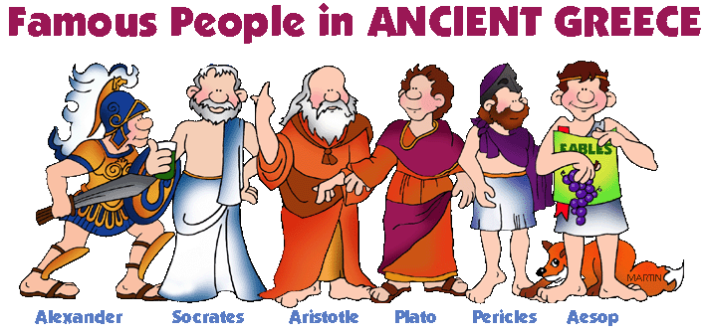
The Greeks
The first-time people tried to find answers to basic questions of life in the power of human reason alone (why man created, who he was, where is he going)
Worshiped human reason and nature
Had difficulty with conflicting concepts that baffle the human mind. These upset their worldview

Slide 6
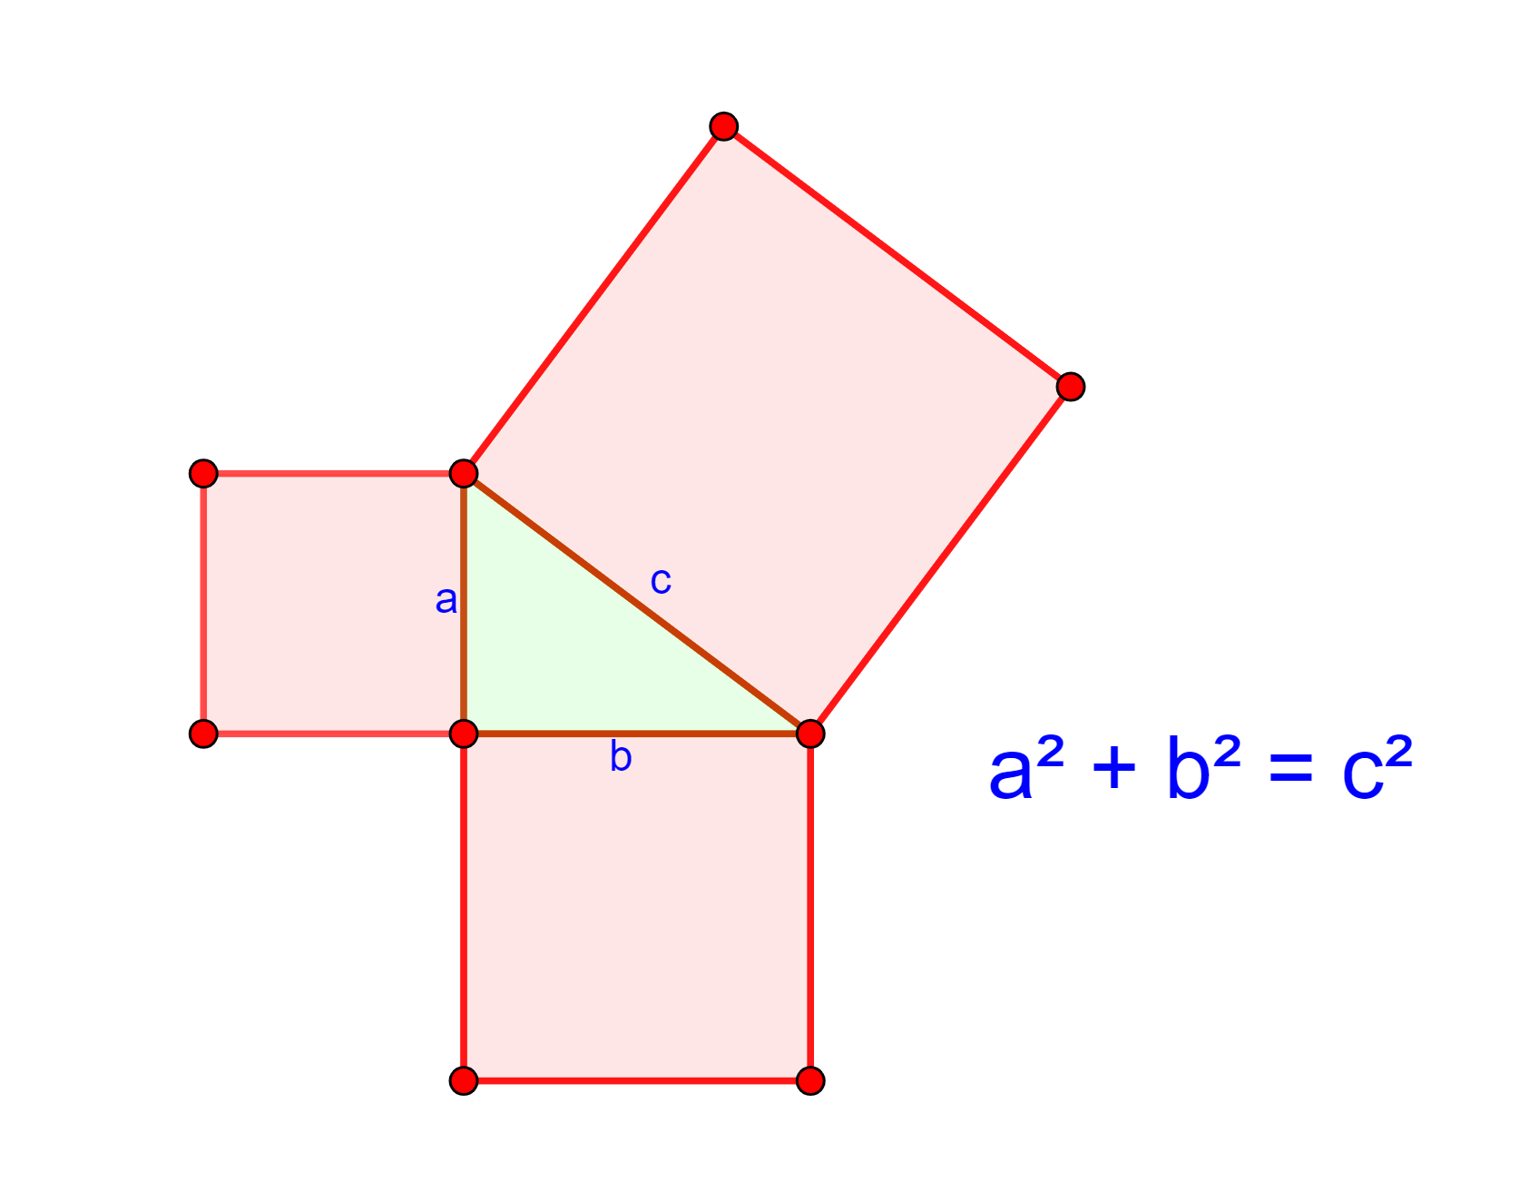
1000 years before Pythagoras the Babylonians knew and used the theorem regarding right angle triangles
  ...but Pythagoras was probably the first to prove it!

Slide 7
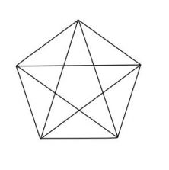
The Brotherhood of Pythagoreans
Followers of Pythagoras (like Jesus)
A secret society
Devoted to the study of mathematics
Like a cult
  Purity (didn’t eat beans as they weren’t ‘pure’)
  Long hair
  Simple clothing
  Went barefoot
Symbol – star pentagon (5-pointed star formed by drawing diagonals of a regular pentagon)

Slide 8
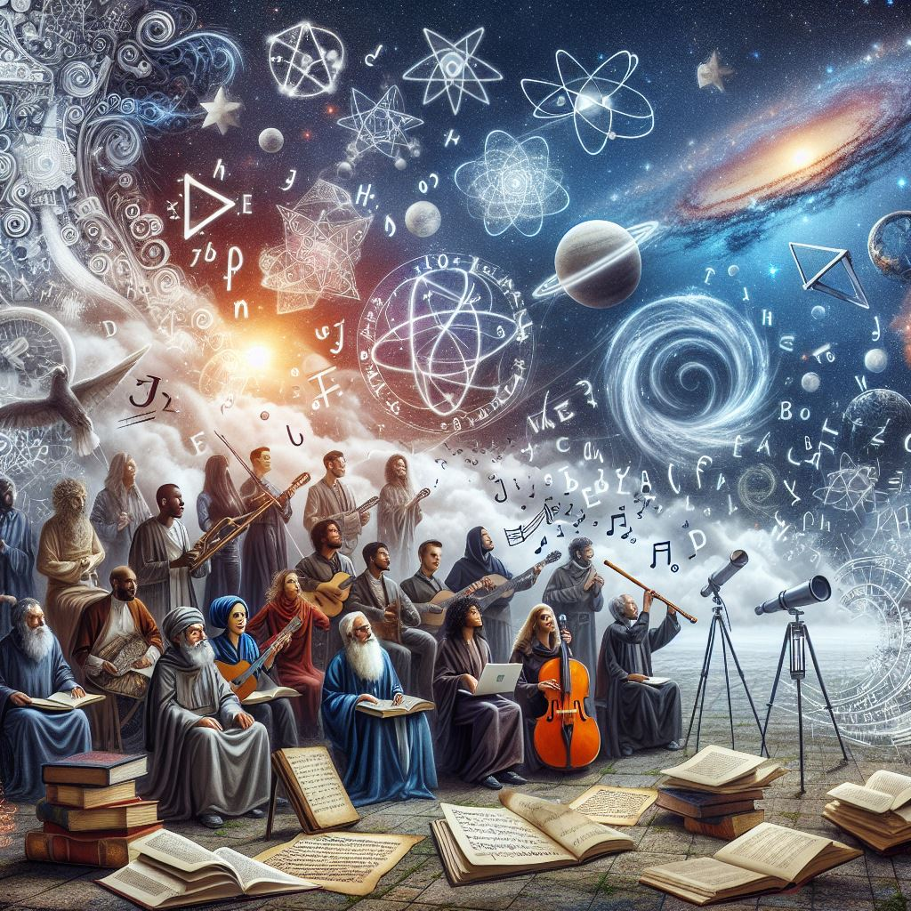
Pythagoreans were interested in:
Philosophy
Music – noise that makes sense
Mathematics - rules that describe how the world works
Astronomy

Slide 9
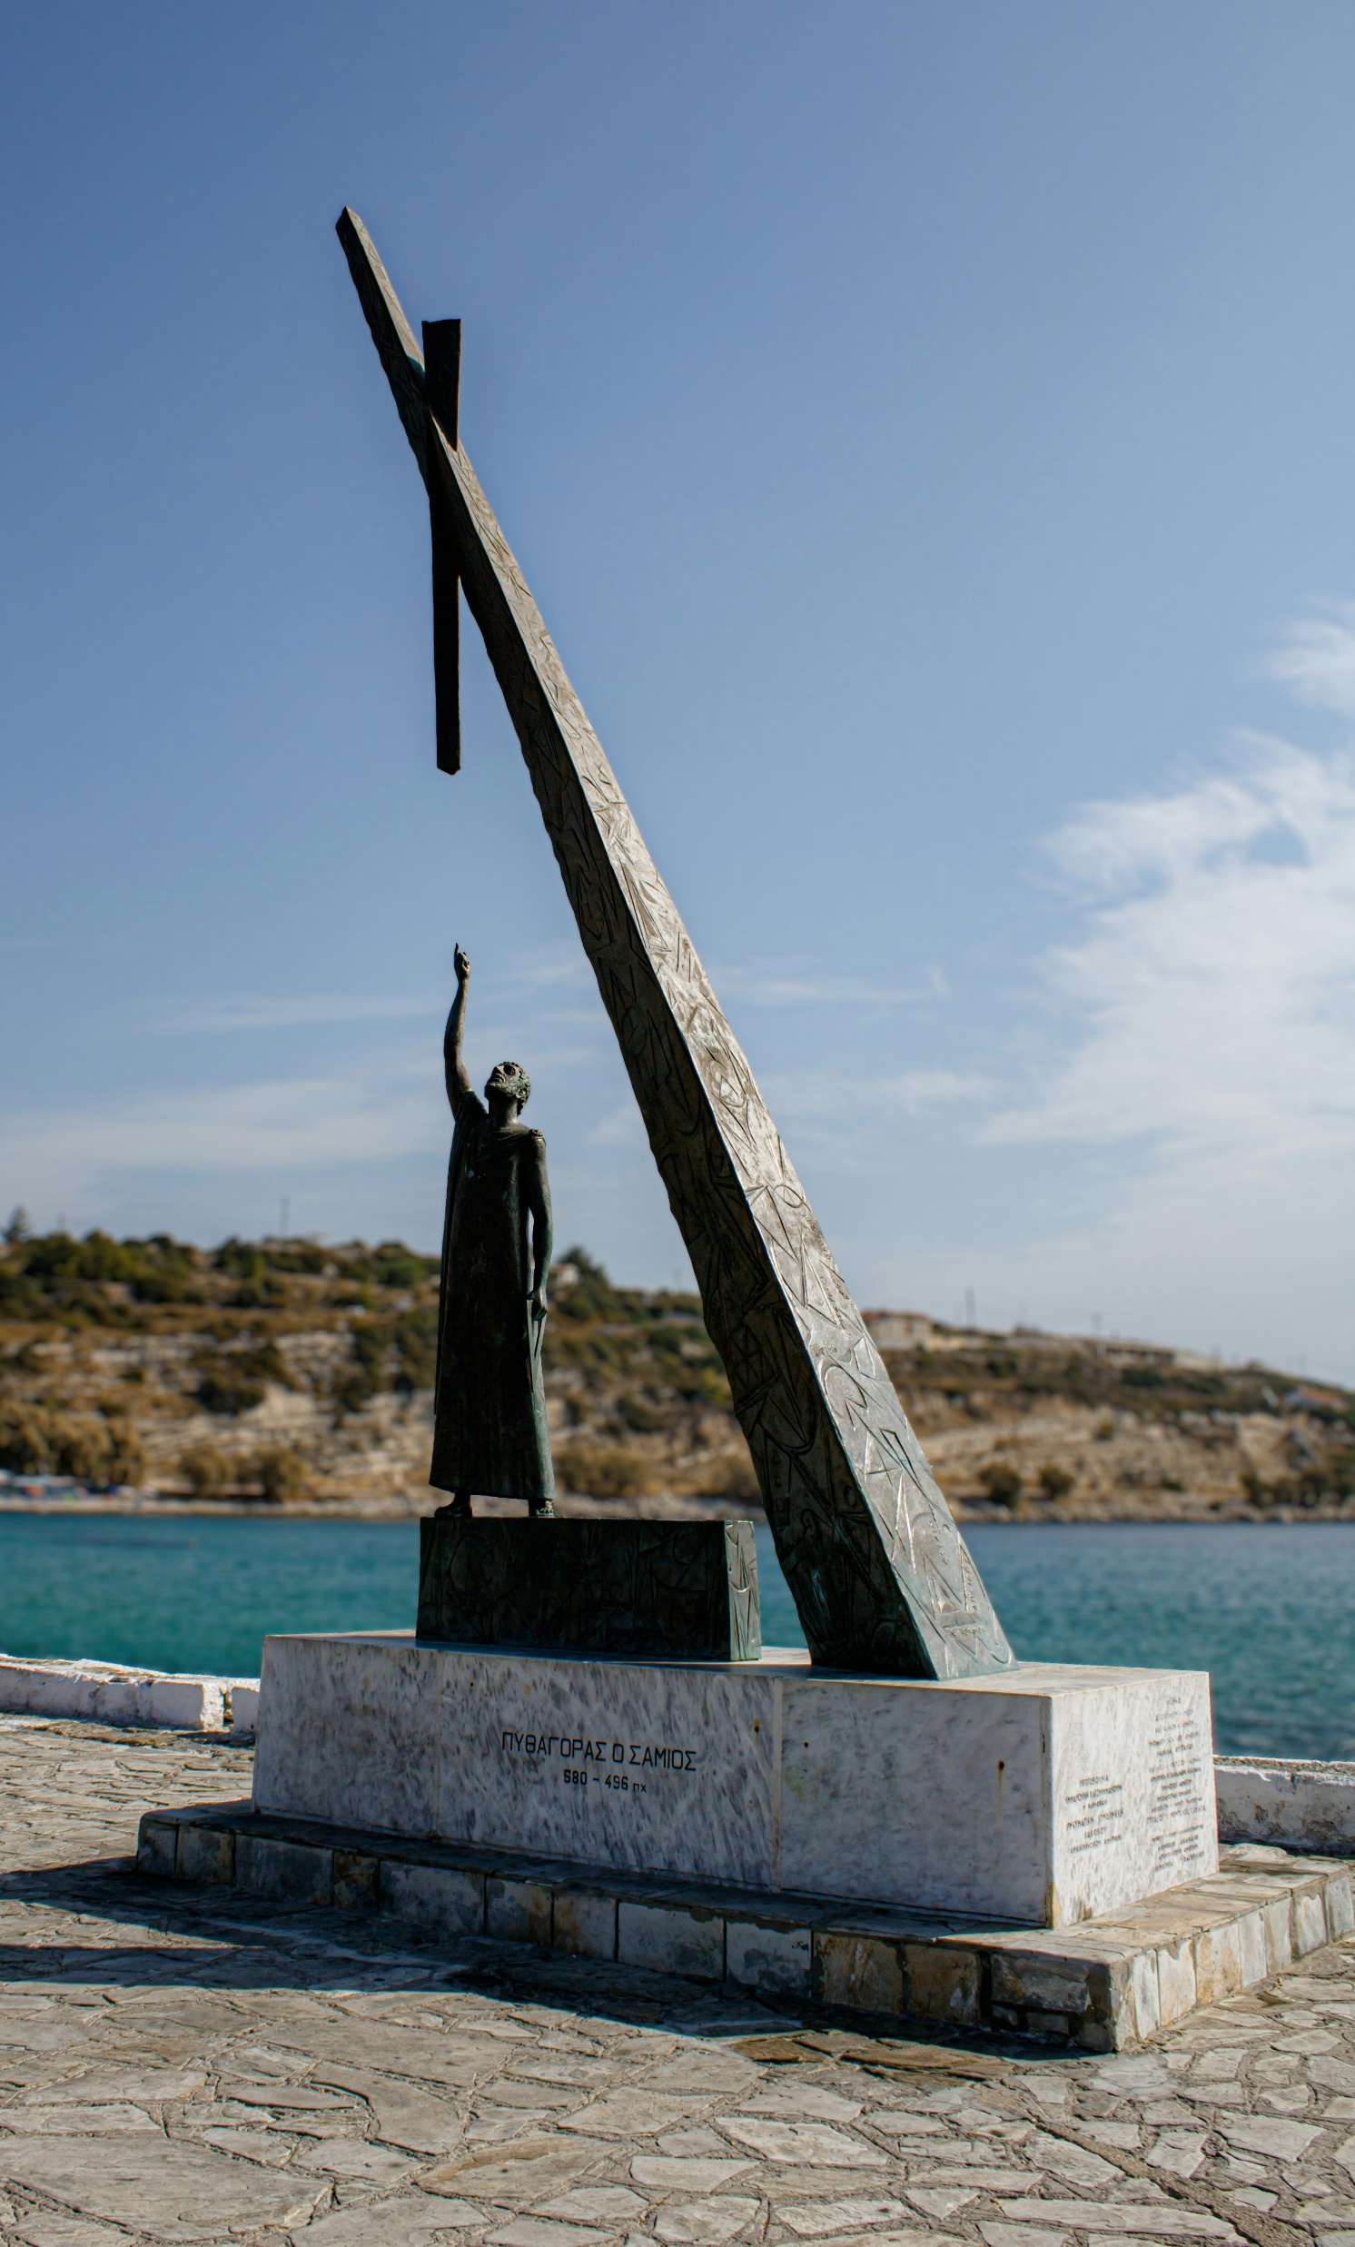
Pythagoras worshipped Maths!
He believed Numbers ruled the world
He believed the whole universe could be explained by counting numbers

Slide 10
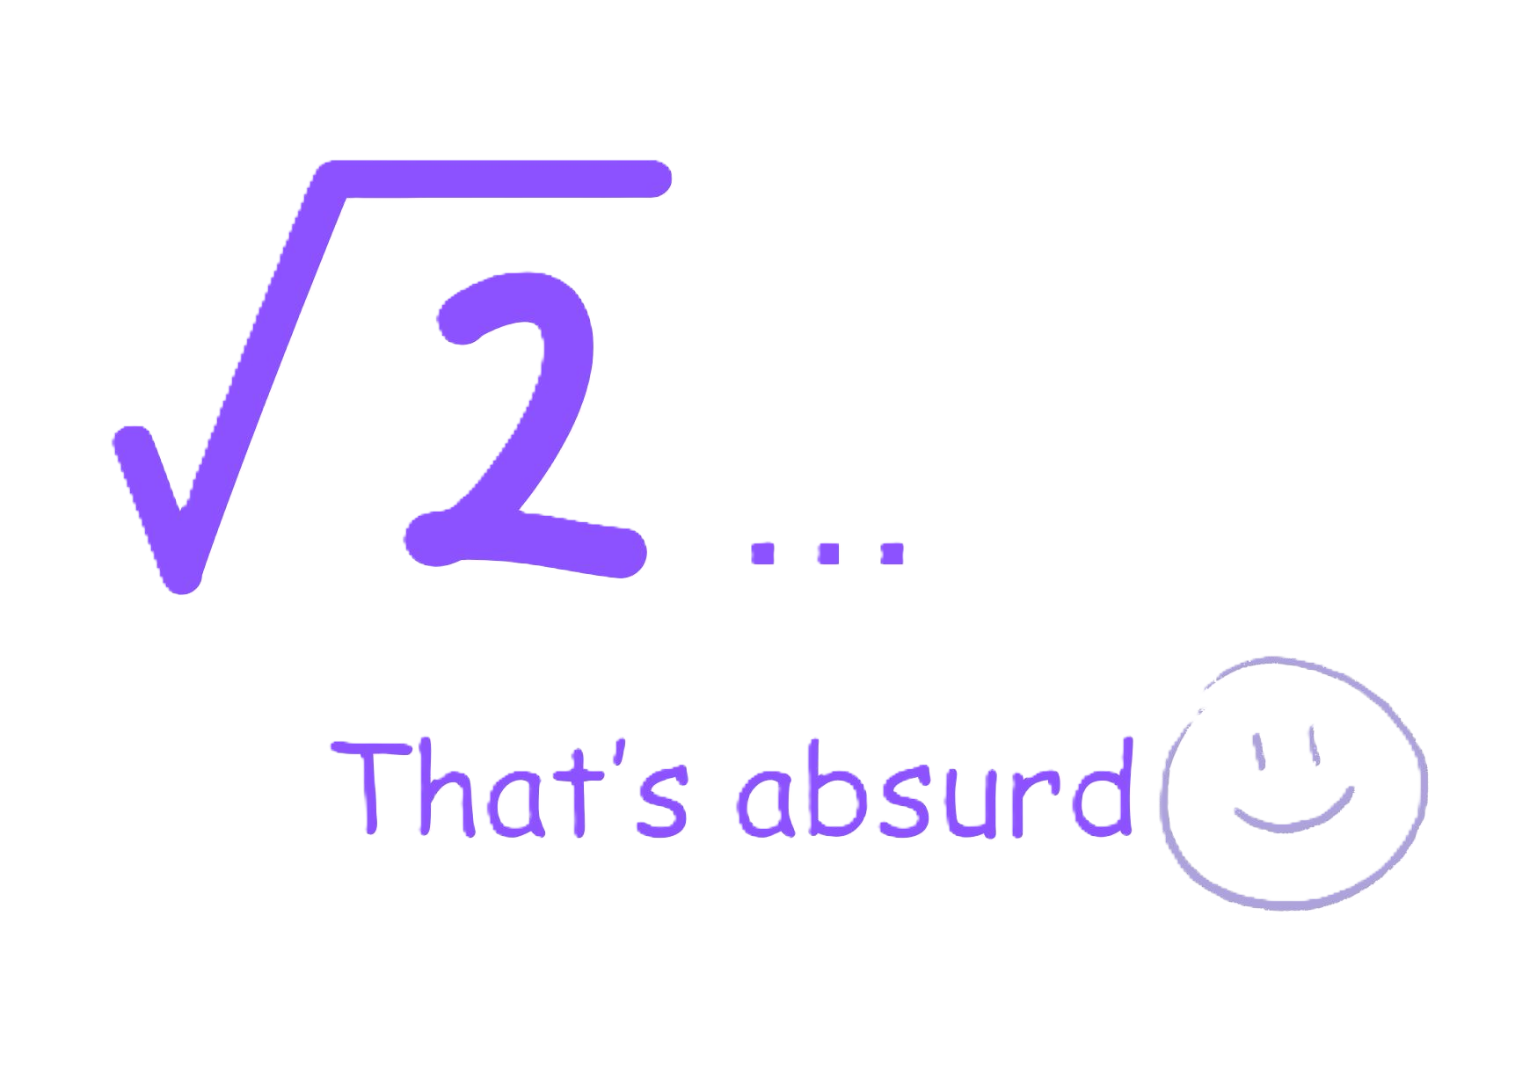
…but he couldn’t cope with surds
Despaired over irrational numbers (a number that goes on forever – it has no ‘exact’ answer)
The original definition of an irrational Number:
  “A number beyond human reason”
It destroyed his world view!

Slide 11
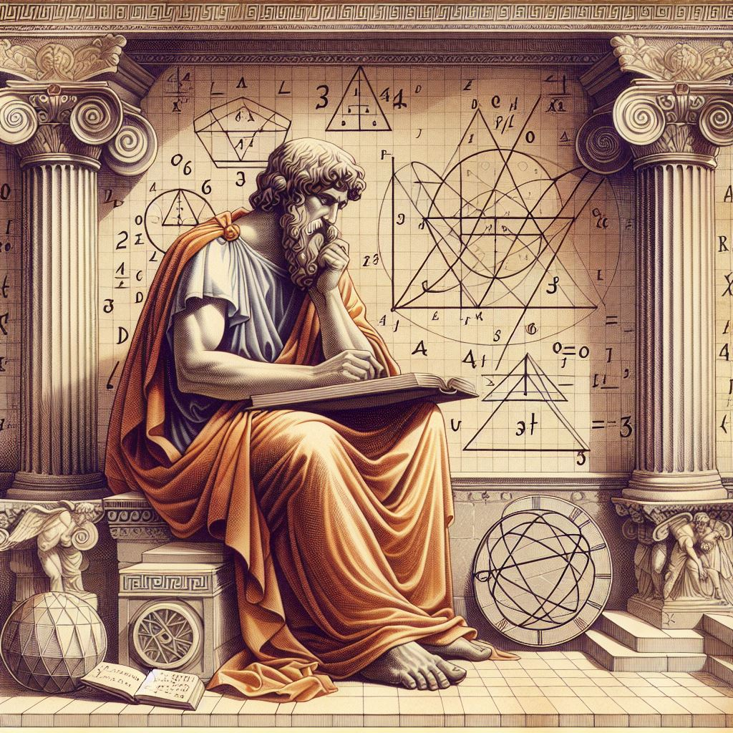
Pythagoras worshipped the created rather than the creator
The Bible says:
  “They exchanged the truth about God for a lie, and worshiped and served created things rather than the Creator—who is forever praised. Amen.” Rom. 1:25

Slide 12

However, God gave numbers as a tool to:
  Observe reality and classy it
  Formulate relationships
  Explain and predict
  Make wise decisions and serve
  Pythagoras worshipped the God given tool – not the God who gave them this tool!

Slide 13
Who or what do you worship?

